Slide 1
Overview
September 2025

Slide 2
Antitrust Policy Notice
Linux Foundation meetings involve participation by industry competitors, and it is the intention of the Linux Foundation to conduct all of its activities in accordance with applicable antitrust and competition laws. It is therefore extremely important that attendees adhere to meeting agendas, and be aware of, and not participate in, any activities that are prohibited under applicable US state, federal or foreign antitrust and competition laws.
Examples of types of actions that are prohibited at Linux Foundation meetings and in connection with Linux Foundation activities are described in the Linux Foundation Antitrust Policy available at linuxfoundation.org/antitrust-policy. If you have questions about these matters, please contact your company counsel, or if you are a member of the Linux Foundation, feel free to contact Andrew Updegrove of the firm of Gesmer Updegrove LLP, which provides legal counsel to the Linux Foundation.

Slide 4
Why Open Source?

Slide 5
Why Open Source?
Software development has a cost
Development
Maintenance
Documentation
Training
Open Source ecosystems share those costs
Empower developers to lead development
Notes:
Why open source? Because software development has a cost, no matter if it is proprietary, commercially available or free. Open Source software shares some of those costs between multiple companies and contributors.

Slide 6




































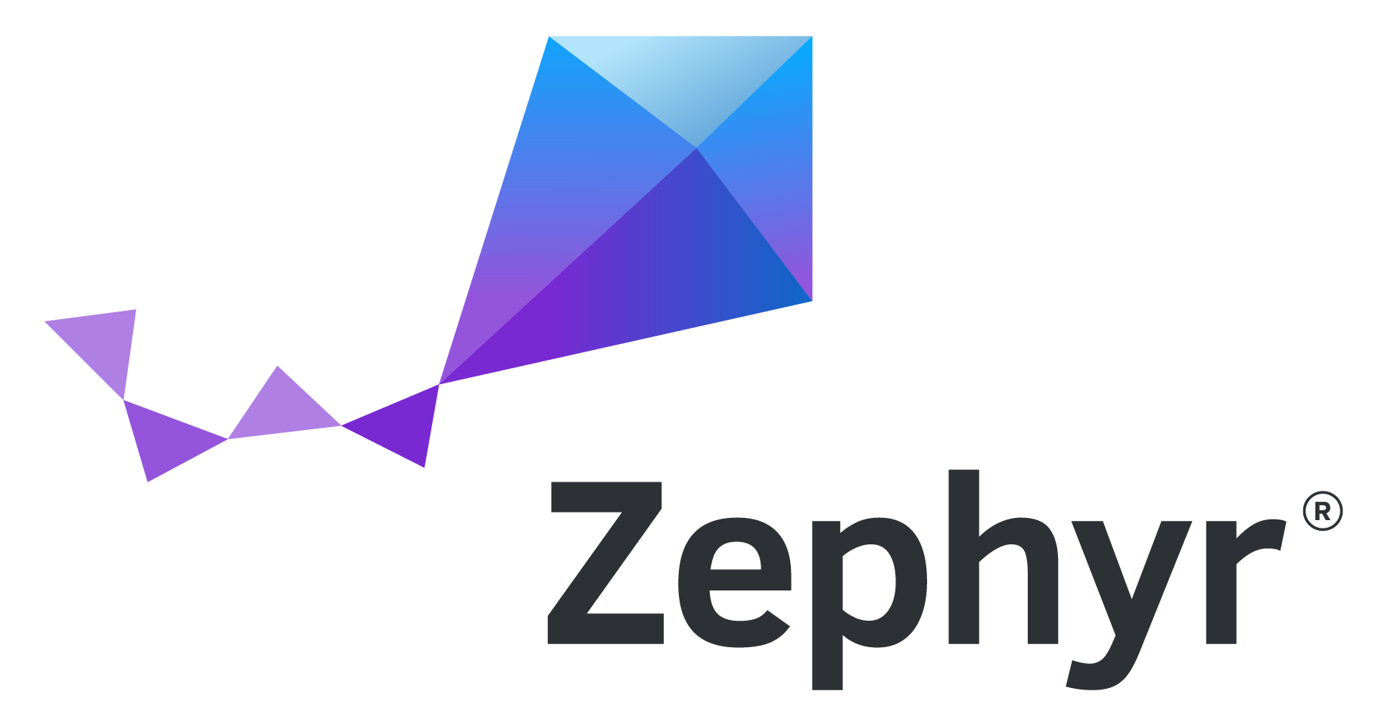














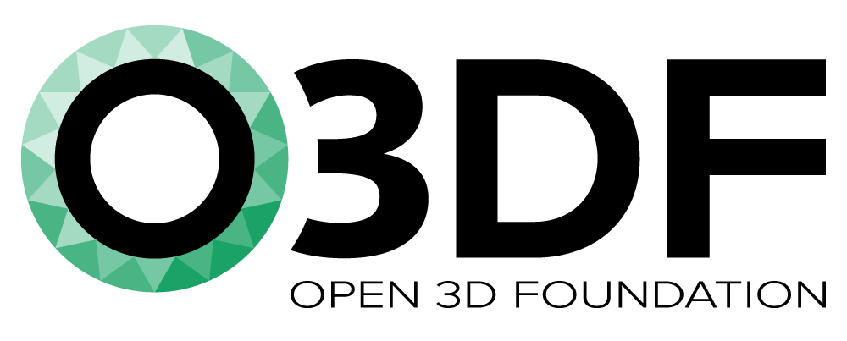































Open Source Projects
Vertical Industry
Security
AI & Data
Cloud
Networking
Edge & IoT
Web
Visual Effects
Sustainability
Digital Trust
Hardware
Standards
LinuxBoot
Electron
Notes:
Over time, communities of open source software developers have grown around hundreds of projects in all industries, and categories from hardware to standards, from Energy to Blockchain from Security to AI to Cloud computing.

Slide 7
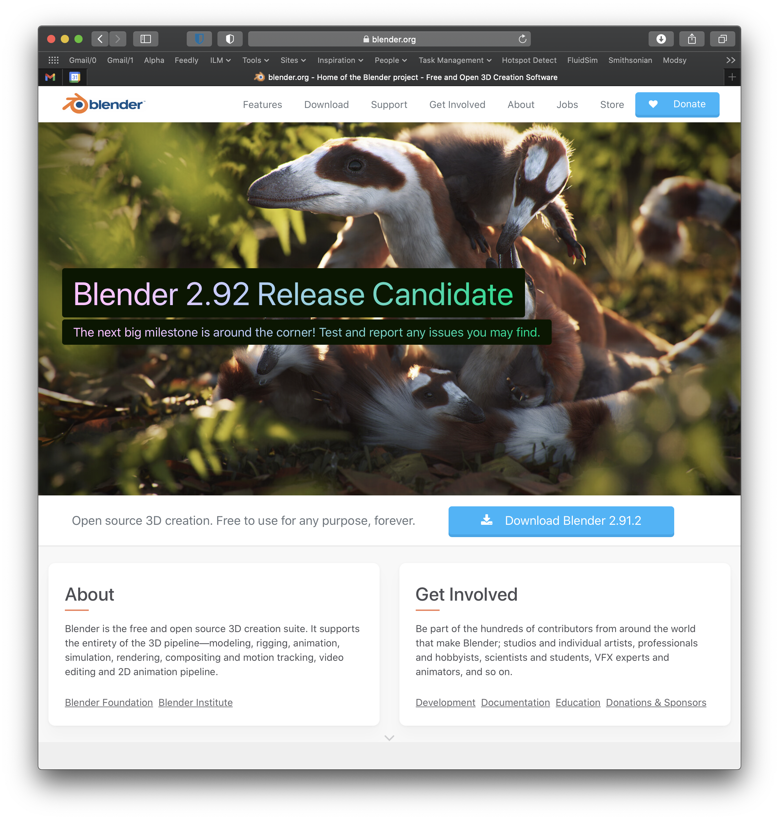
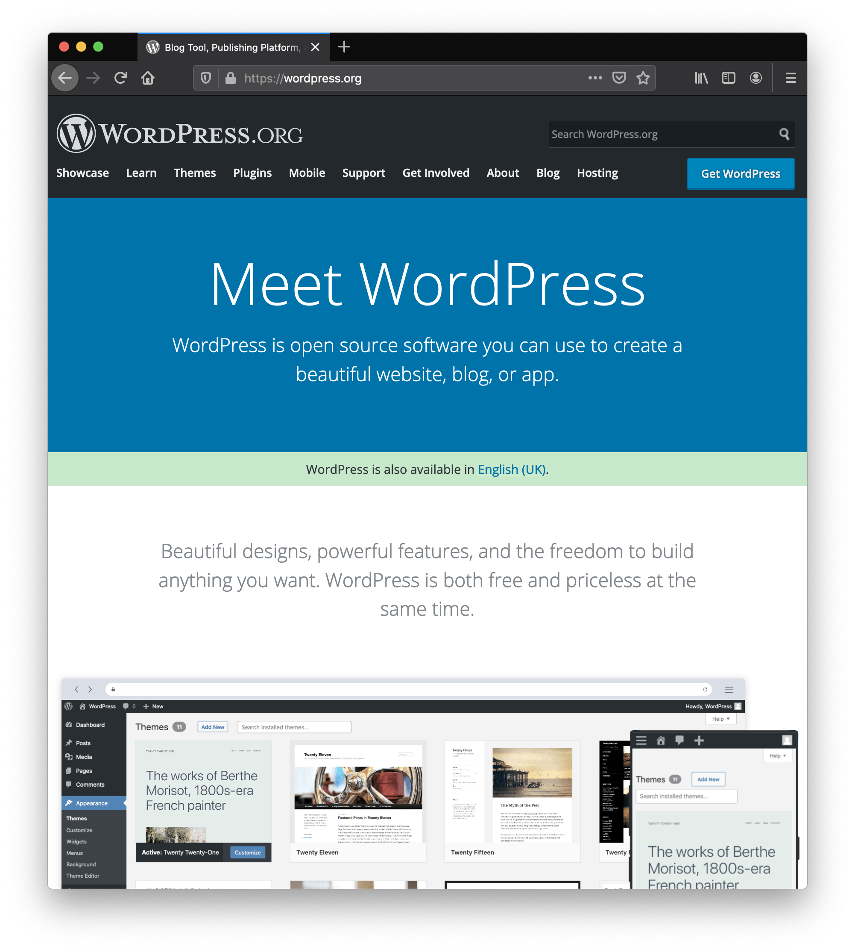
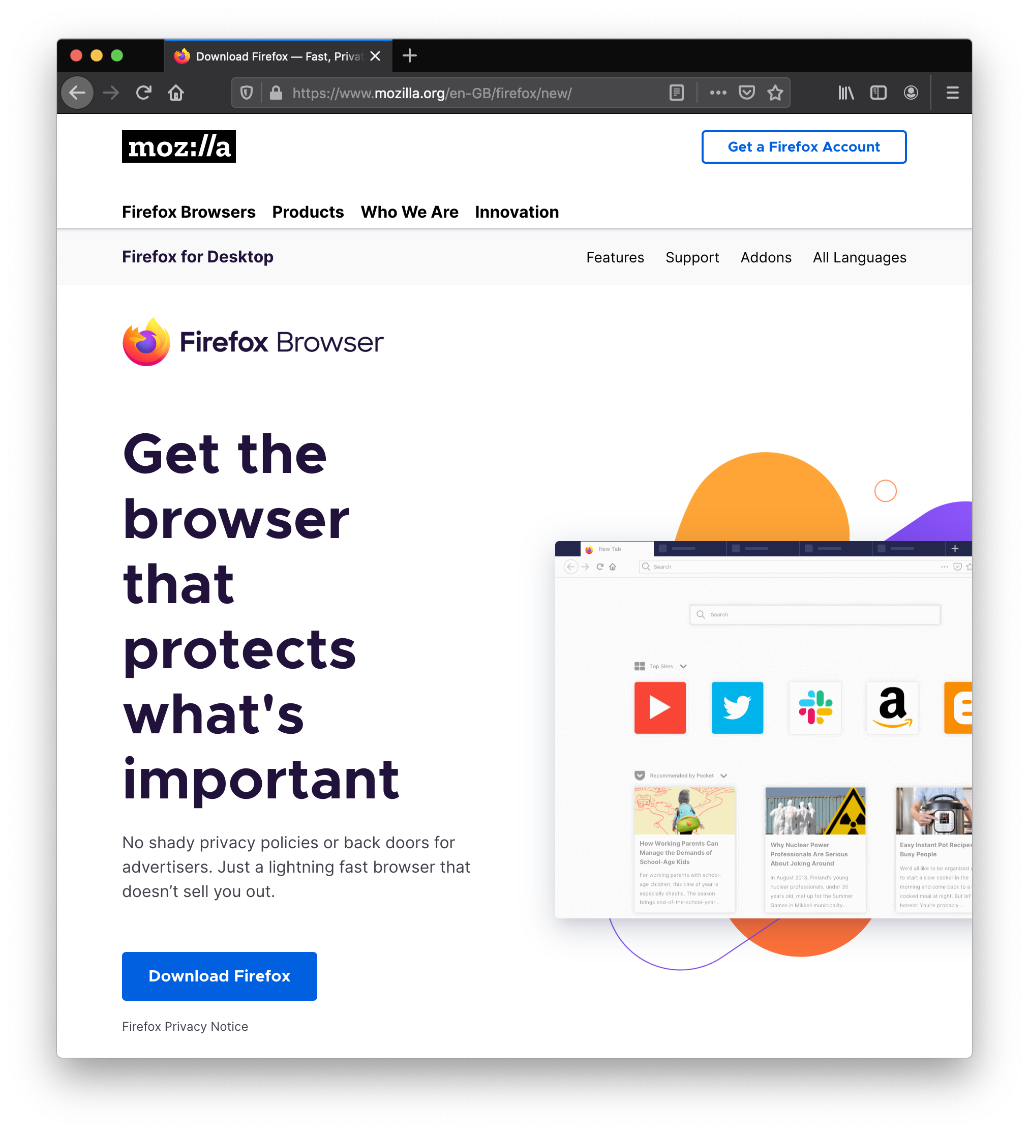
Notes:
And it’s not just libraries and developers tools. Firefox, Blender, Wordpress for instance are great example of end user tools that have a vibrant open source community around them.

Slide 8
Open Source: Innovation Accelerator
Neutral environment for collaboration & cross-pollination
Standardization on open technologies
Innovation multiplier
Enables better interoperability
Minimizes fragmentation
Qualifies reference architectures
Lowers barriers to enter a new domain
Enables new business opportunities
Leads to better products
Allows shared cost of development
Notes:
Open source can really be an enabler for all these things.

Slide 9
About the Academy Software Foundation
Notes:
In that context, why the ASWF, and more particularly what benefits was it set out to bring to the Film industry?

Slide 10
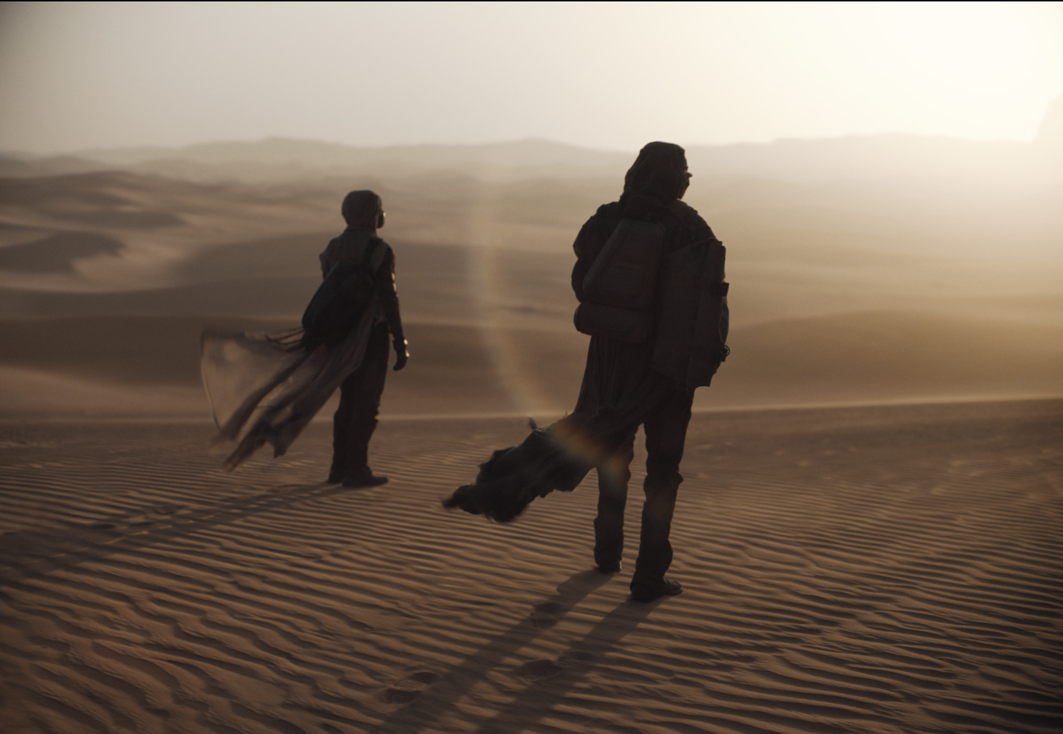

Open Source in Entertainment
How the Academy Software Foundation Creates Shared Value
A report from
Written by
Barbara Robertson
report.aswf.io
DUNE Image Courtesy of DNEG © Legendary
Warner Bros. Entertainment Inc. All Rights Reserved.
Notes:
Thank you Tim. First I want to talk about our Open Source in Entertainment report that was released yesterday at report.aswf.io. This is the cover - I like this image because it is of a woman and a man, looking into the light, toward a better future, part of a sequence of images, that were transported through OpenEXR, color managed through OpenColorIO, in a movie that has won a few awards and will, probably, maybe, win a few more. We want to thank DNEG and Warner Bros for providing this image, and the many of you who also provided images for the report. We want to thank the many of you who were interviewed for it, and for giving us the benefit of your insight and experience. This document is the first report on Open Source in Entertainment, and it tells the story of open source in our industry, and the history our Foundation: where we came from, what we achieved so far, and where we aim to go next. For people and companies already participating in the Foundation it is a record. For those who are looking at participating, it is a primer. Please read it!

Slide 11


An Open Source Foundation Developed in Partnership
The Academy Software Foundation provides a neutral forum for open source software developers in the motion picture and broader media industries to share resources and collaborate on technologies for image creation, visual effects, animation and sound.
Notes:
The Academy Software Foundation was developed in a partnership between the Academy of Motion Picture Arts and Sciences and the Linux Foundation, both partners bringing a unique blend of film industry knowledge and open source technical and organizational expertise to create a unique organization dedicated to accelerate software development and innovation in the motion picture industry.

Slide 12

Why the Academy Software Foundation?
Legal Framework
Continuous Integration and Build Infrastructure
Clear path to accepting contributions (neutral forum)
Versionitis
Notes:
These were some of the problems that the Foundation set out to solve.

Slide 13
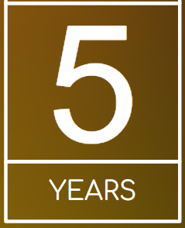

ASWF created
Open Source Forum 2022
Open Source Days 2024
Open Source Days 2025
01
01
First project
Open Source
Day 2019
Open Source Days 2020
Open Source Days 2021
March 10,2022
Rez
DPEL
Raw2ACES
August 10, 2018
Founding members:
Animal Logic
Autodesk
Blue Sky Studios
Cisco
DNEG
DreamWorks Animation
Epic Games
Foundry
Google Cloud
Intel
SideFX
The Walt Disney Studios
Weta Digital
Open Source
Days 2022
Open Source Days 2023
July 23-29 2024
Samsung
Caligra
August 4-10
ACES
DNA
RMTC
LAIKA
Skydance Animation
October 23,2018
OpenVDB
New members:
Sony Pictures Entertainment
Warner Bros.
Blender Foundation
Visual Effects Society
July 29, 2019
OpenTimelineIO
Netflix
Amazon Web Services
Rodeo FX
MovieLabs
Aug19-20 2020
Unity
Conductor Technologies
SMPTE
August 4-5 2021
MaterialX
Maxon
August 8-9, 2022
OpenFX
OpenAssetIO
Open Review
Initiative
Canonical
Khronos Group
July 25 -
August 7, 2023
OpenImageIO
Otoy
Bolt Graphics
Coreweave
Open Source
Forum 2025
12
17
Feb 13 2025
OpenAPV
Stability.ai
RaynaultVFX
Apr 16
2020
Open
Shading
Language
AMD
DockYard
10
Sept 13
2019
Apple
Microsoft
08
Dec. 15
2020
Adobe
ETC
Jan. 28
2022
Wevr
19
05
Open Source
Forum 2024
15
Feb 8, 2019
OpenColorIO
13
Open Source
Forum 2023
Feb 22 2024
Mod Tech
Labs
11
18
02
Feb 16 2023
HP
Framestore
May 1 2019
06
09
03
OpenEXR
OpenCue
NVIDIA
ftrack
Red Hat
07
16
14
Scitech
Council
Open source
Investigation
concludes
04
August
Oct
Feb
May
August
Oct
Feb
August
Jan
August
Feb
August
Feb
August
Feb
August
Feb
August
2018
2019
2020
2021
2022
2023
2024
2025

Slide 14
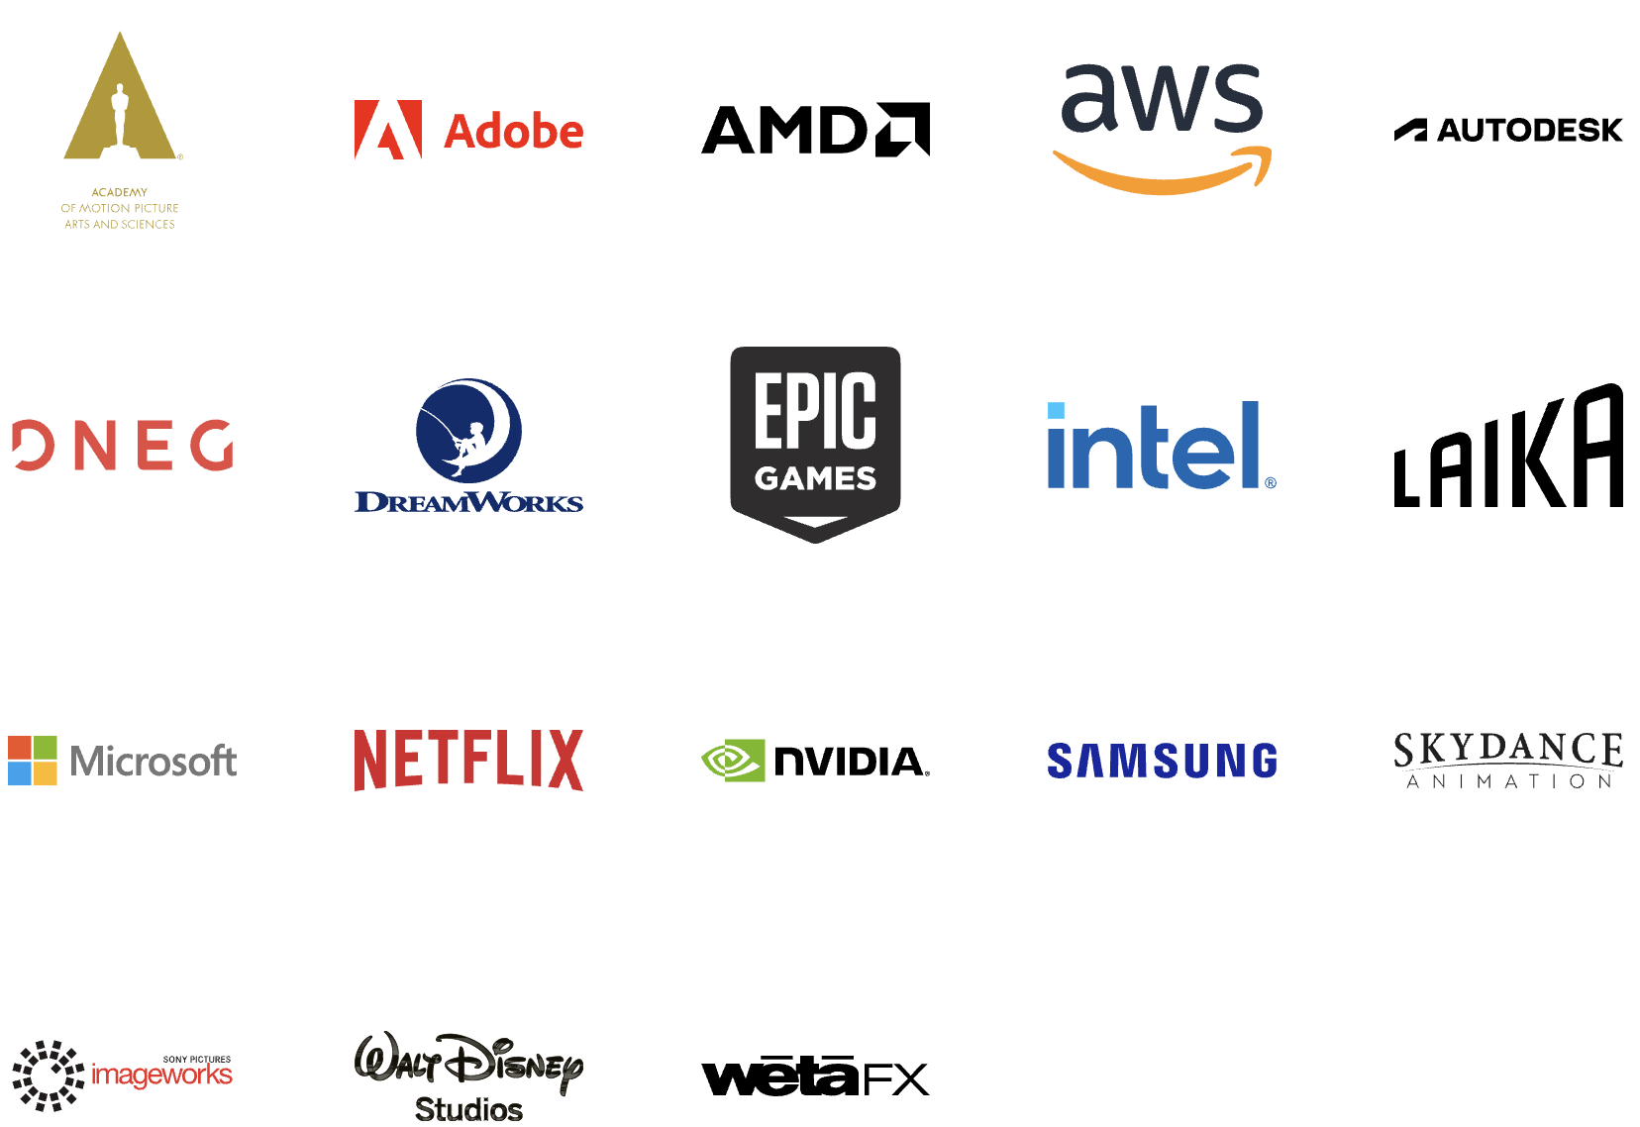
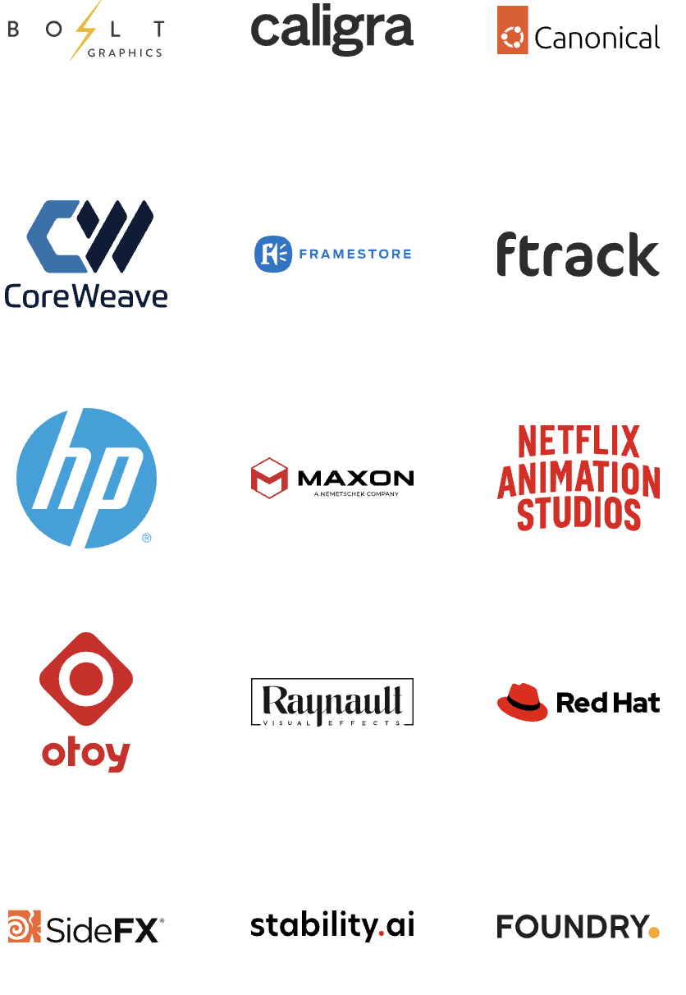
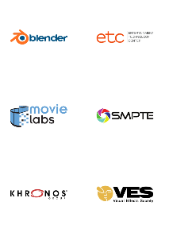

Membership
Premier
General
Associate
Notes:
Source: https://landscape.aswf.io/embed/embed.html?base-path=&key=aswf-member-company&headers=true&category-header=false&category-in-subcategory=false&title-uppercase=false&title-alignment=left&title-font-family=sans-serif&title-font-size=13&style=clean&bg-color=%232b8ca0&fg-color=%23ffffff&item-modal=false&item-name=false&size=lg&items-alignment=left

Slide 15
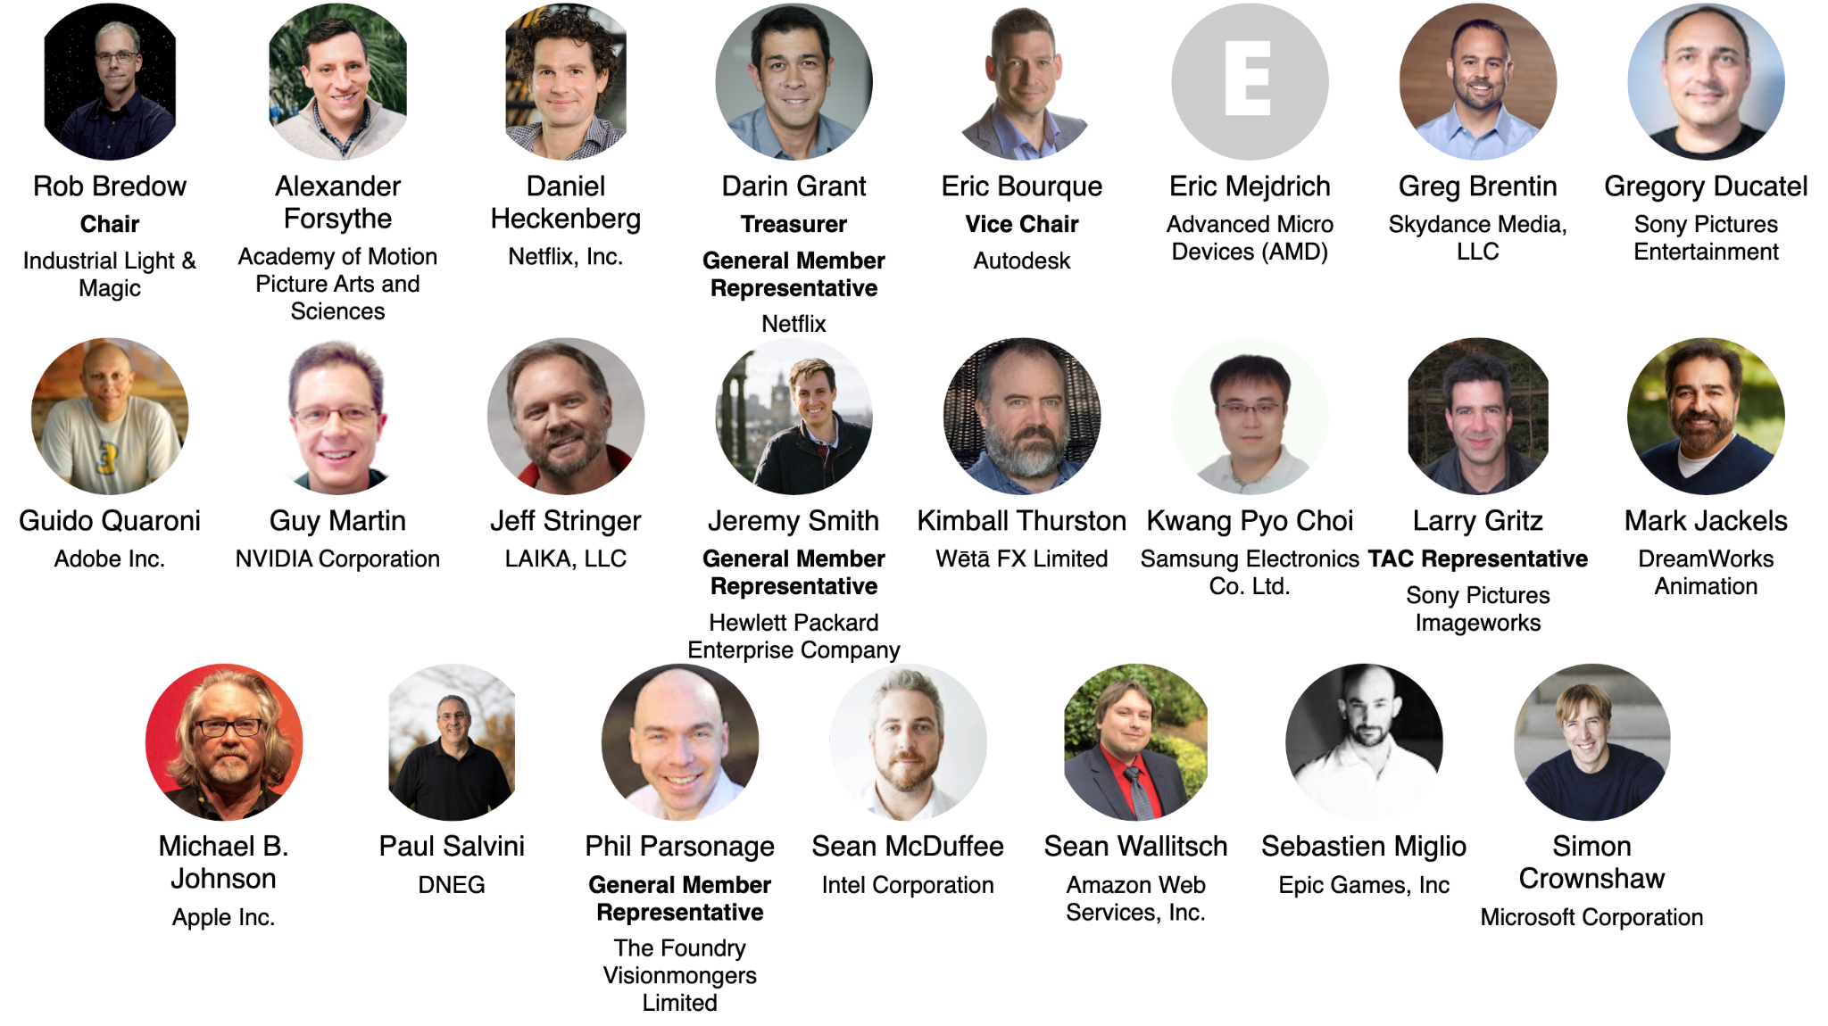
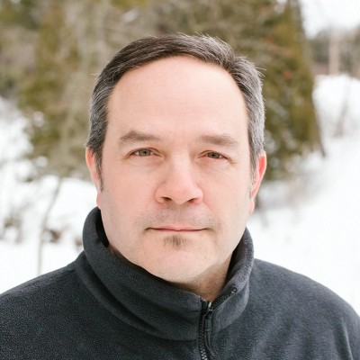
Governing Board Representatives
Notes:
https://jmertic.github.io/committee-gallery/academy-software-foundation-governing-board

Slide 16
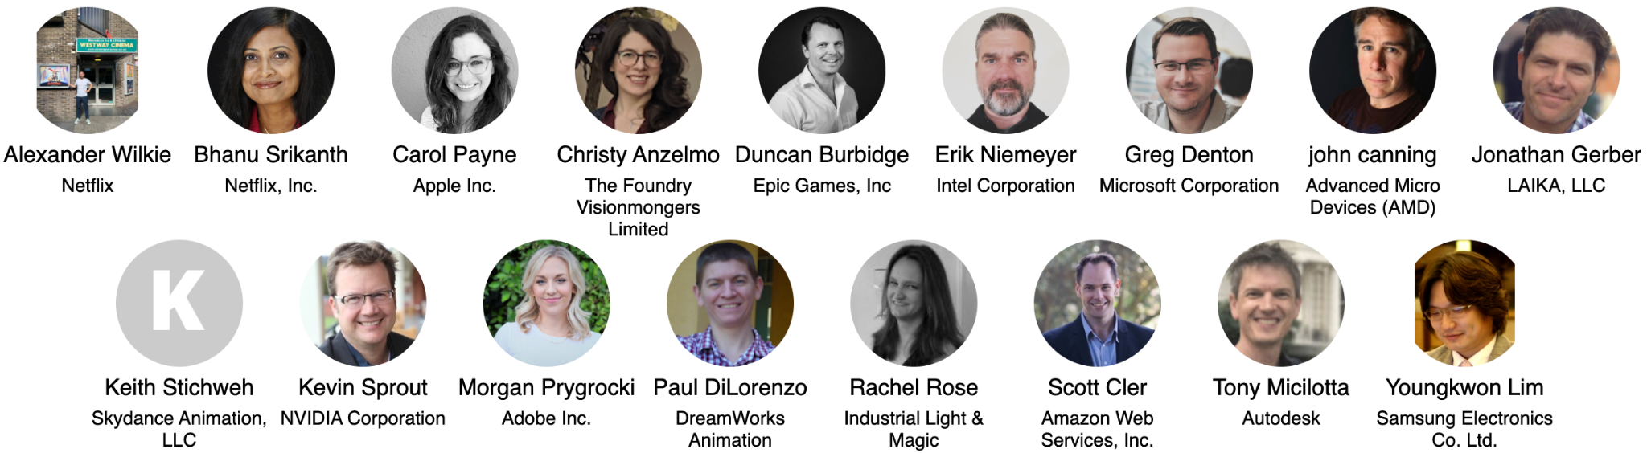
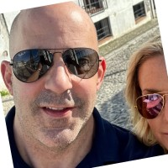
Governing Board Alternates
Notes:
https://jmertic.github.io/committee-gallery/academy-software-foundation-governing-board_slidedeck_alternates

Slide 17
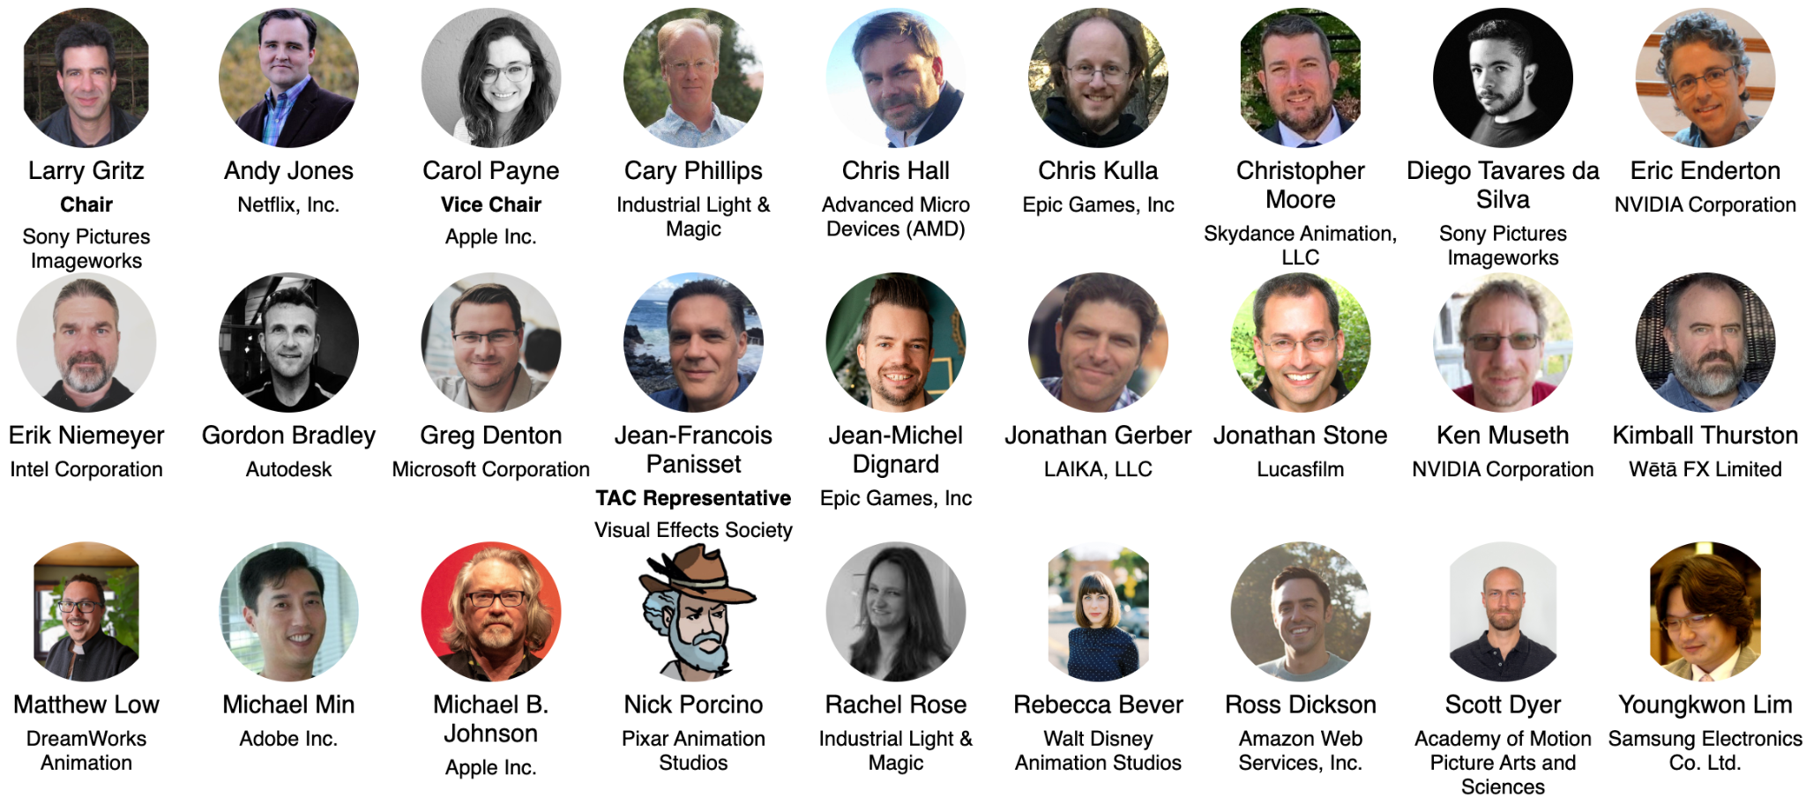
Technical Advisory Council (TAC)
Notes:
https://jmertic.github.io/committee-gallery/academy-software-foundation-tac

Slide 18
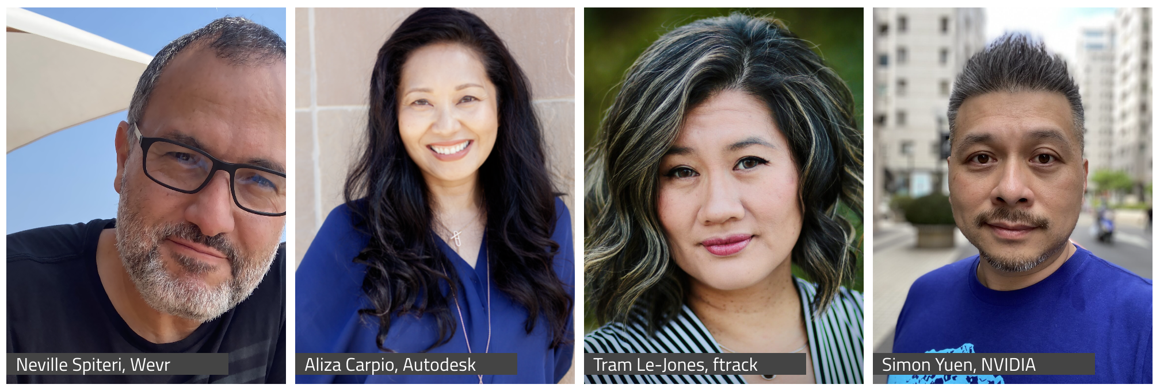
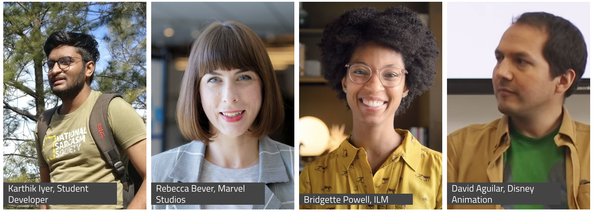
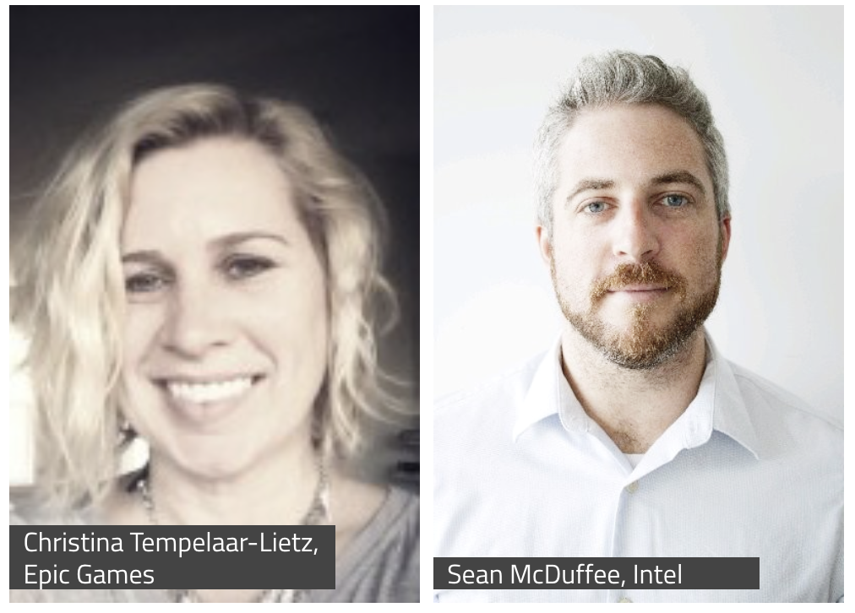
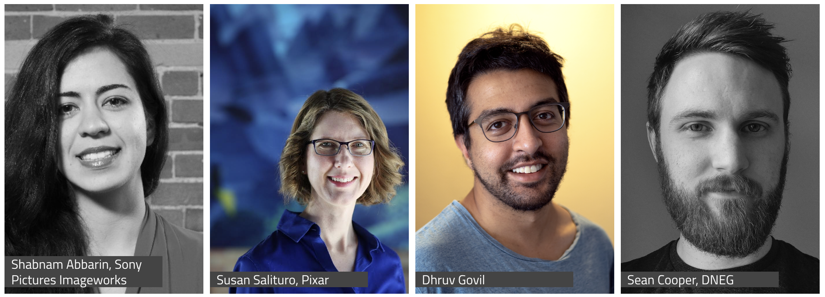
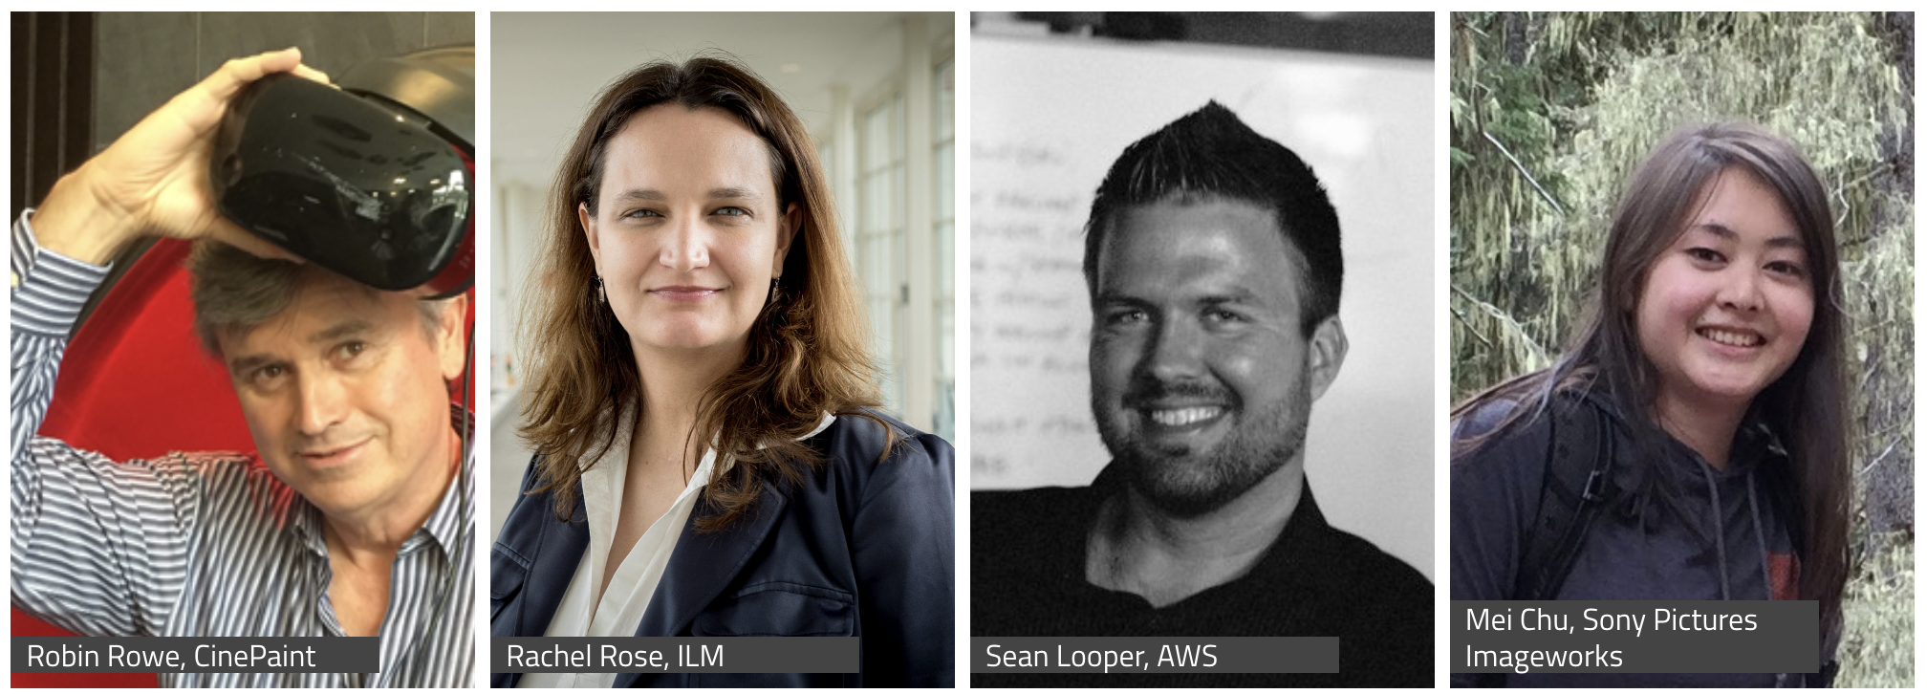
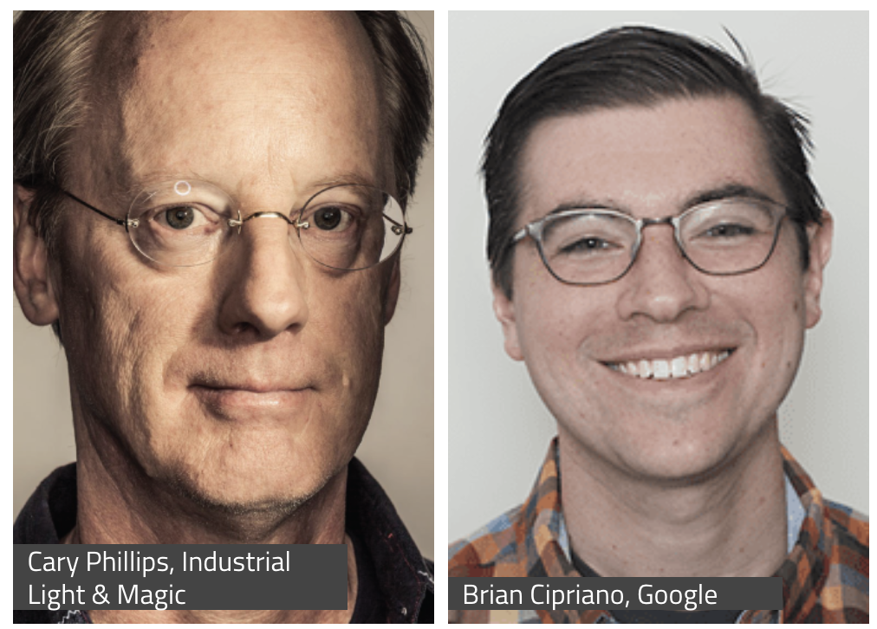
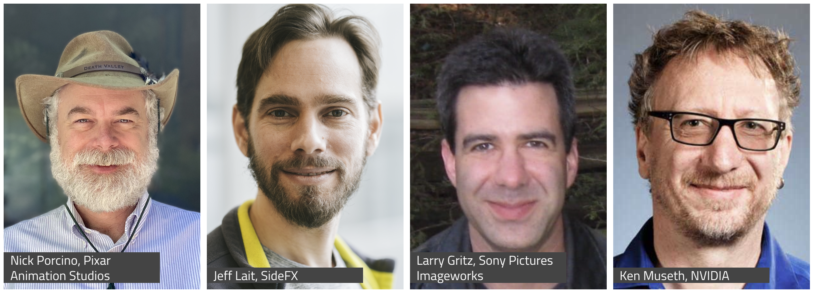
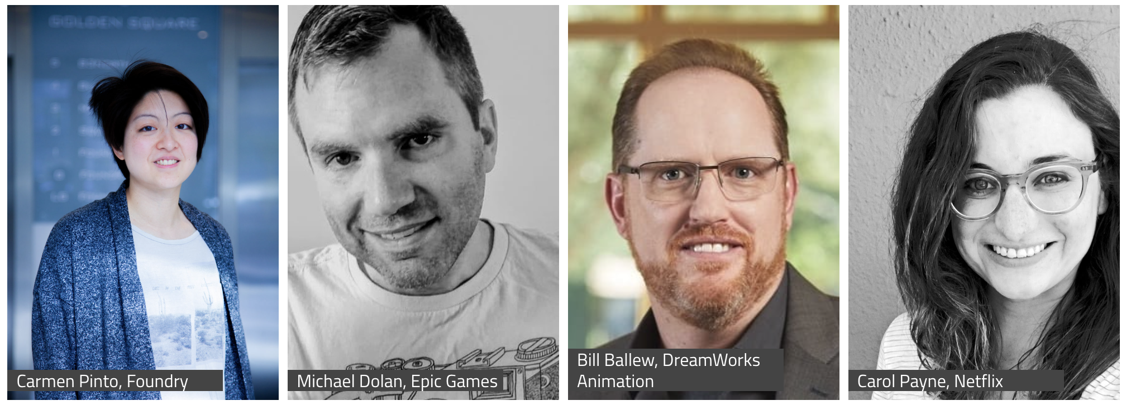
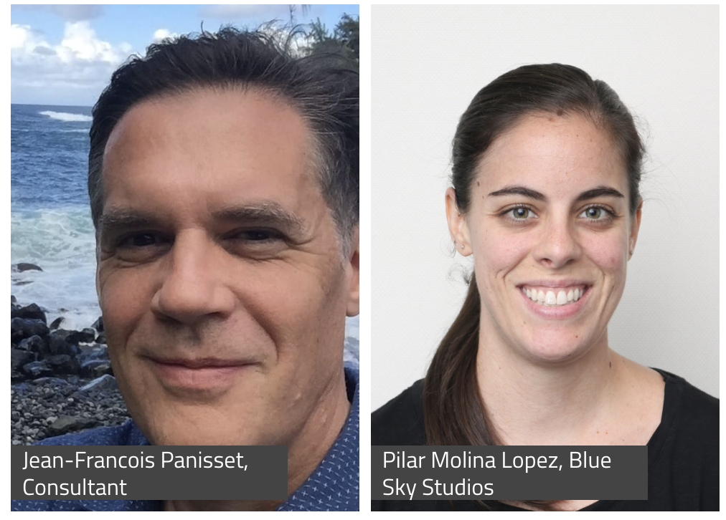
Behind the Screens
aswf.io/behind-the-screens
Notes:
Source: https://www.aswf.io/behind-the-screens/

Slide 19
Our Mission
Increase the quality and quantity of open source contributions by establishing a governance model, a legal framework and a community infrastructure that lowers the barrier to entry for developing and using open source software.

Slide 20
Our Goals
Provide a neutral forum to coordinate cross-project efforts, establish best practices and share resources.
Develop an open continuous integration (CI) and build infrastructure to enable reference builds from the community.
Streamline development for build and runtime environments through the sharing of open source build configurations, scripts and recipes.
Provide individuals and organizations with a clear path for participation and code contribution.
Provide better, more consistent licensing through a shared licensing template.
Create working groups for exploration of new or larger projects.
Focus on diversity and inclusion and raising the profile of software engineers in our industry.

Slide 21
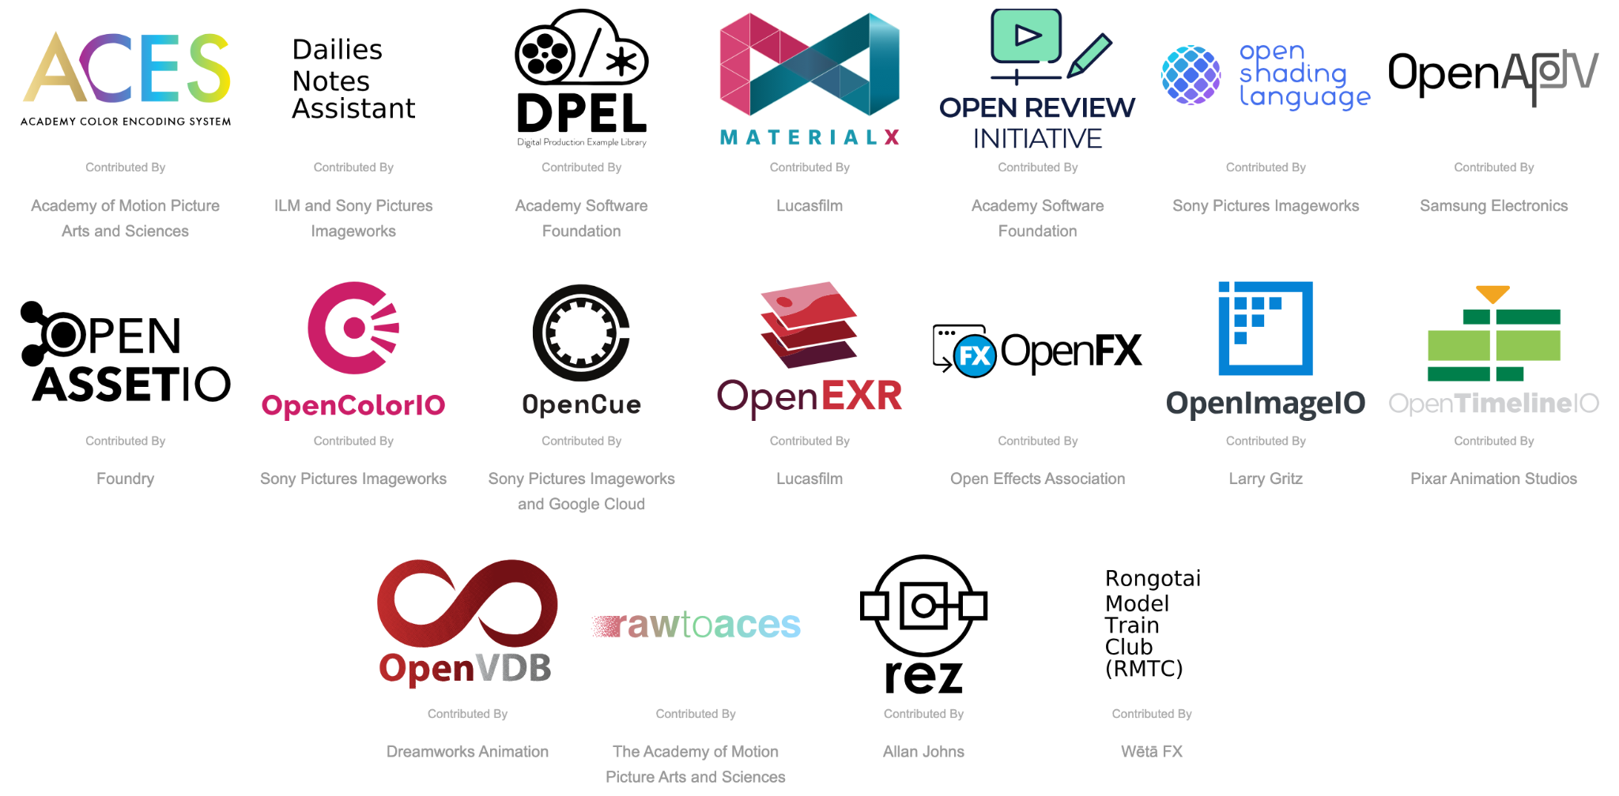
Our Projects
Notes:
Source: https://tac.aswf.io/projects_with_contributed_by

Slide 22
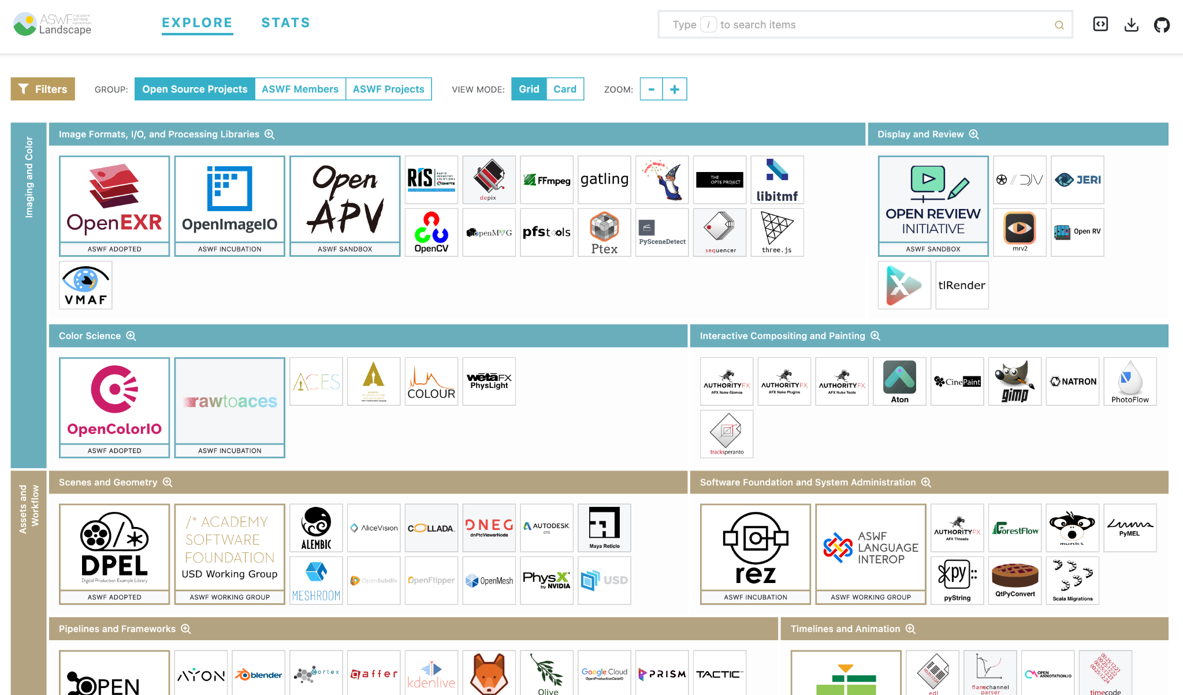
ASWF Landscape
l.aswf.io
Public list of open source projects in the animation and VFX industry
Updates can be submitted via GitHub
Goal is to have all active, open source projects in animation and VFX industries represented.
Notes:
Source: https://landscape.aswf.io/screenshot

Slide 23


Annual, by-invitation event that gathers business and technical leaders to shape the future of open source software across the motion picture and media industries.
opensourceforum.aswf.io
February 13, 2025
Los Angeles, CA + Virtual
2026 Date To Be Announced
Annual developer focused event showcasing the latest from Academy Software Foundation projects along with other open source projects used for visual effects, animation, and image creation.
opensourceforum.aswf.io
August 10, 2025
Vancouver, Canada + Virtual

Slide 24


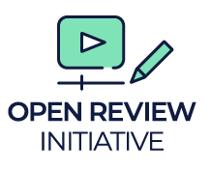

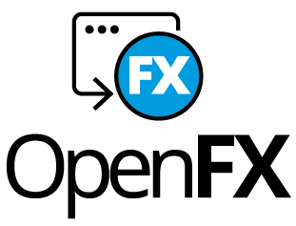








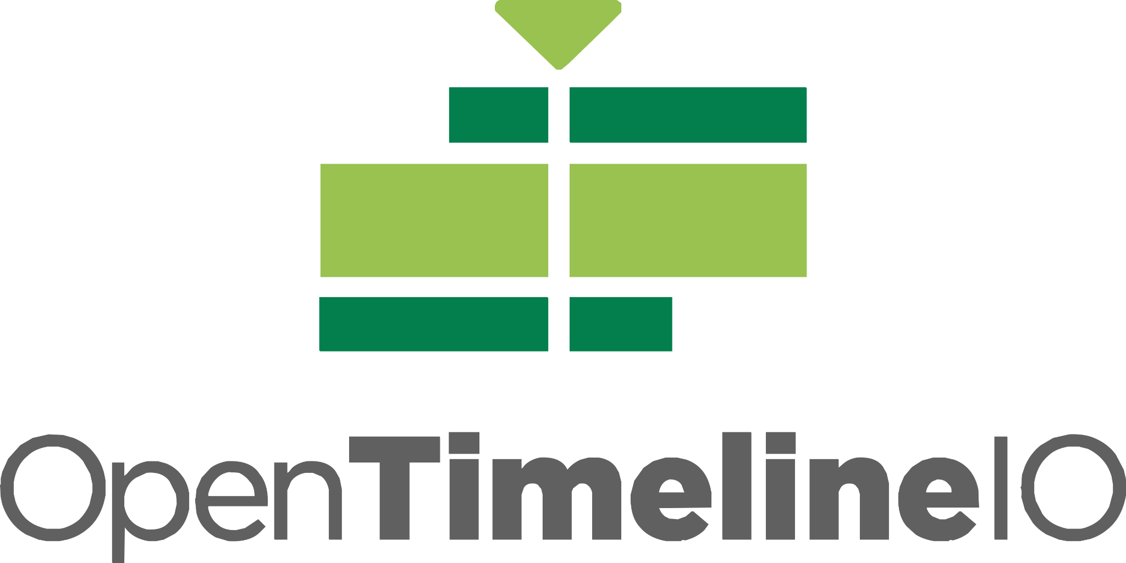


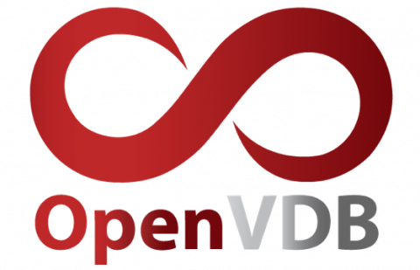
Academy Software Foundation
Structure
TAC
Technical Advisory Council
Governing Board
Outreach Committee
RMTC
DNA
rawtoaces
Continuous Integration platform

Slide 25
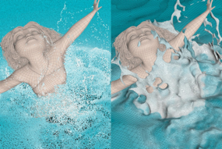
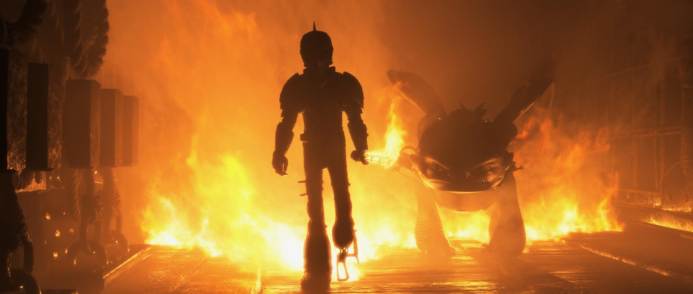
How to Train Your Dragon: The Hidden World; courtesy of DreamWorks Animation
The Croods; courtesy of DreamWorks Animation
First project adopted by ASWF in Sept. 2018; first project to graduate to adopted status in July 2019.
Developed by DreamWorks Animation in 2012.
C++ library for volumetric representations including fluid simulations, animated volumes and environmental effects.
Academy Technical Achievement Award recipient.
Key contributors include DreamWorks, Autodesk, DNEG, Industrial Light & Magic, NVIDIA, SideFX, Weta Digital.
openvdb.org
Notes:
Used on films including Boss Baby, Trolls, The Croods, and How to Train Your Dragon: The Hidden World
Since joining:
Released v6.0, v6.1, v7.0 (above + bug-fixes & optimizations)
New collaborations (Autodesk/Nvidia)

Slide 26
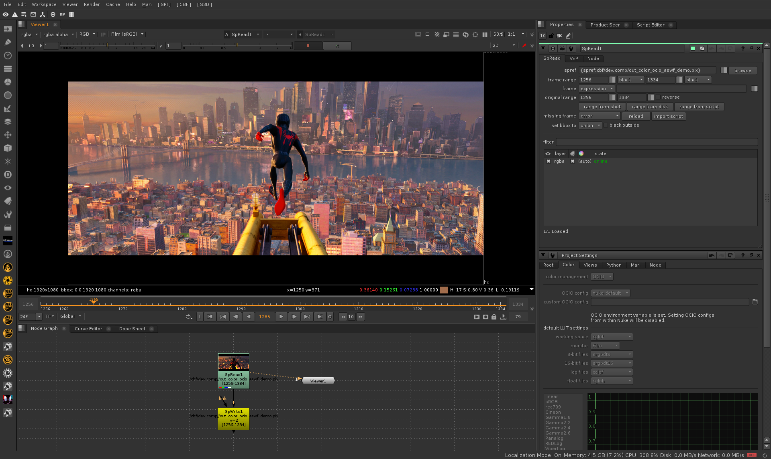
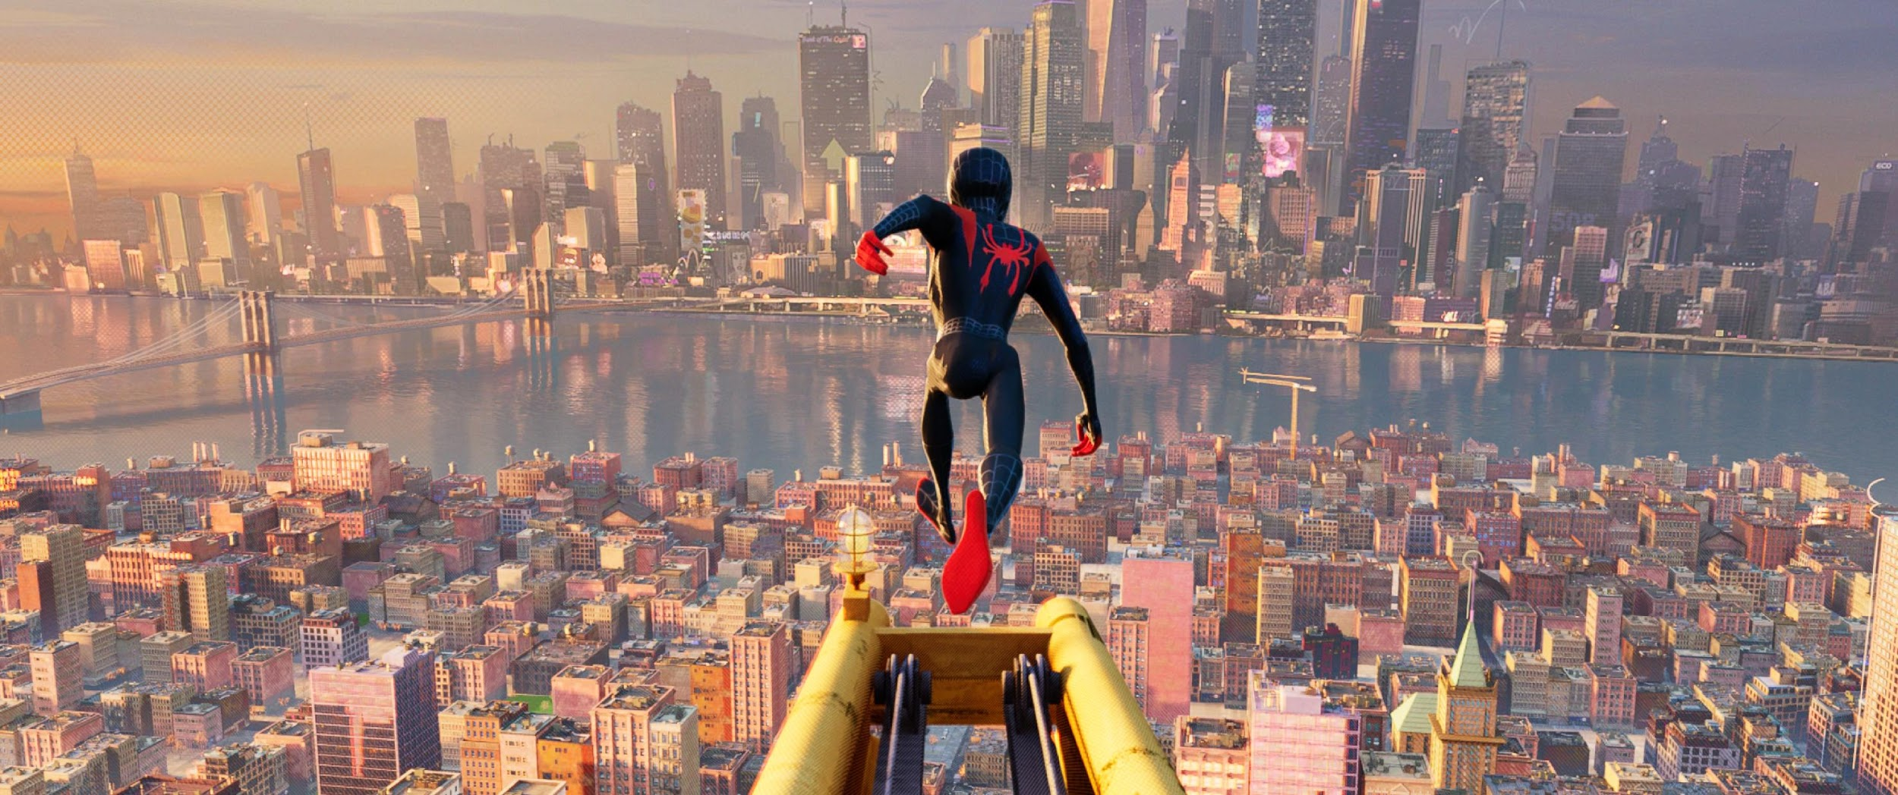
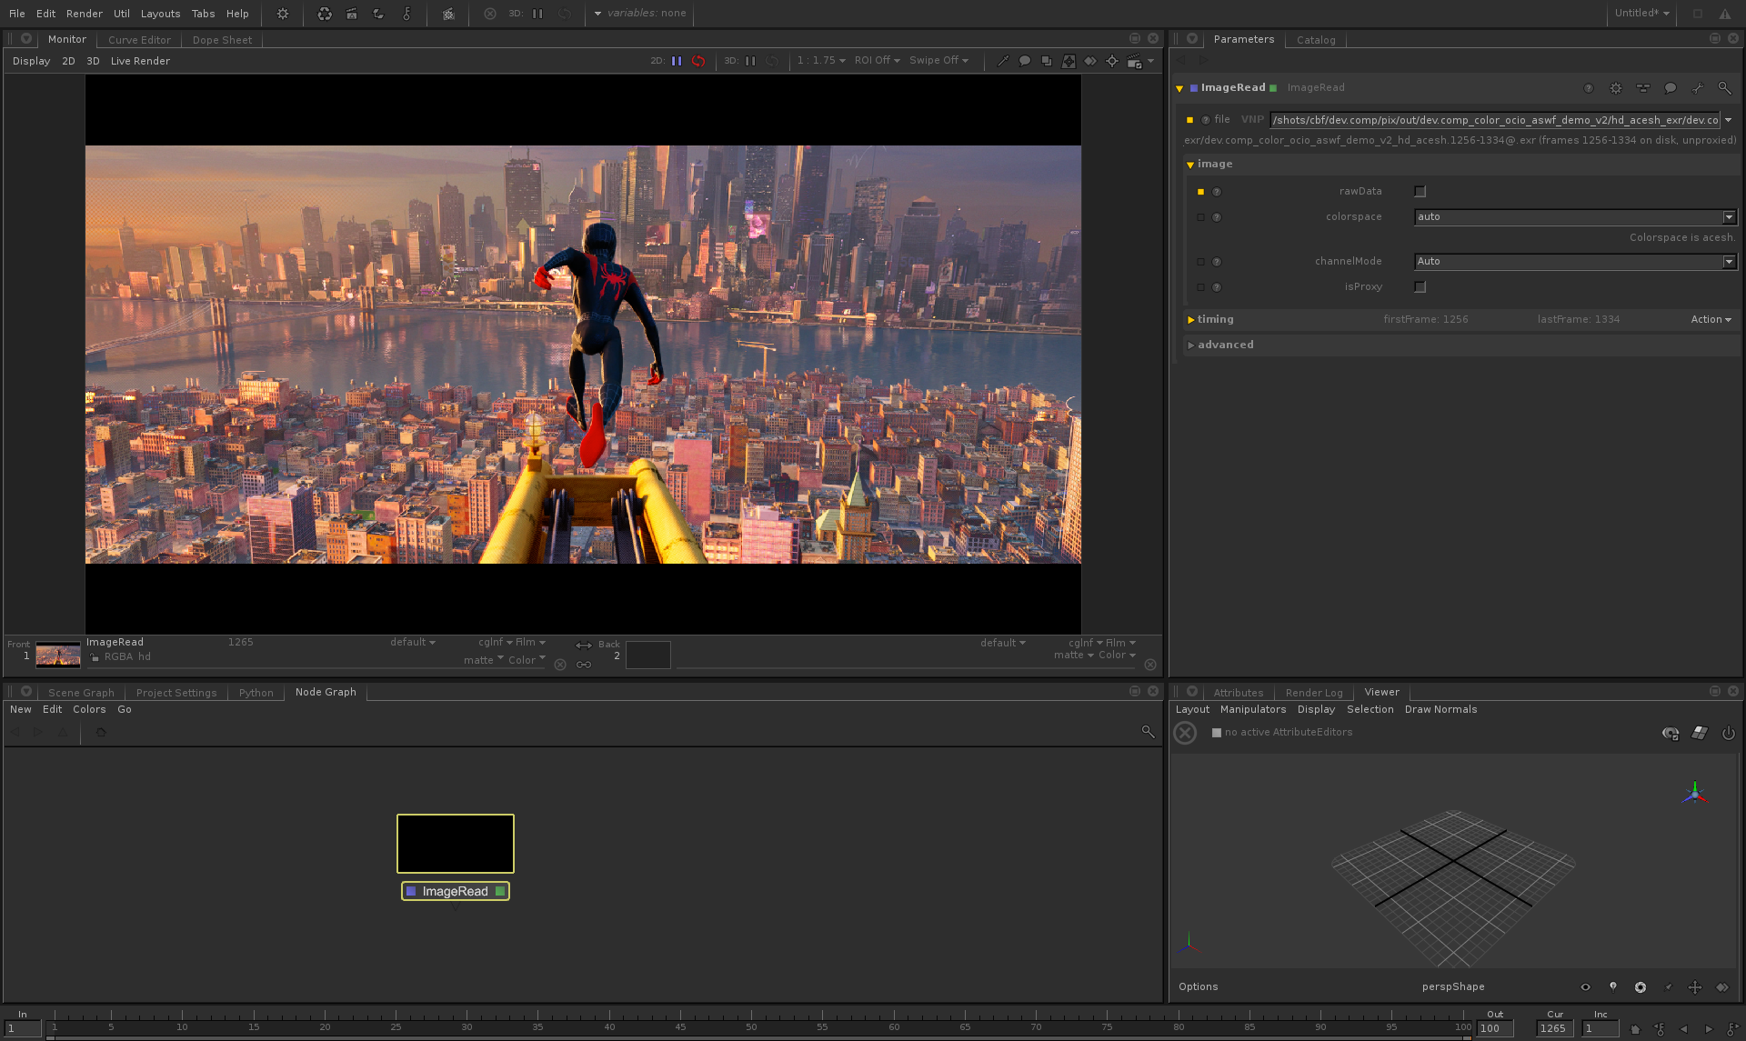
Nuke
Spider-Man™: Into the Spider-Verse; all images courtesy of Imageworks
Joined ASWF in Feb. 2019; adopted status in Nov. 2019.
Developed by Sony Pictures Imageworks in 2003.
Provides a consistent user experience across digital content creation applications; widely adopted in VFX and computer animation studios and software.
Academy Technical Achievement Award recipient.
Key contributors include Imageworks, Autodesk, DNEG, ILM, Foundry, Framestore.
OCIO v2 released fall 2020, led by Autodesk.
Katana
opencolorio.org
Notes:
Top image is in Foundry’s Nuke, bottom in Foundry’s Katana

Slide 27
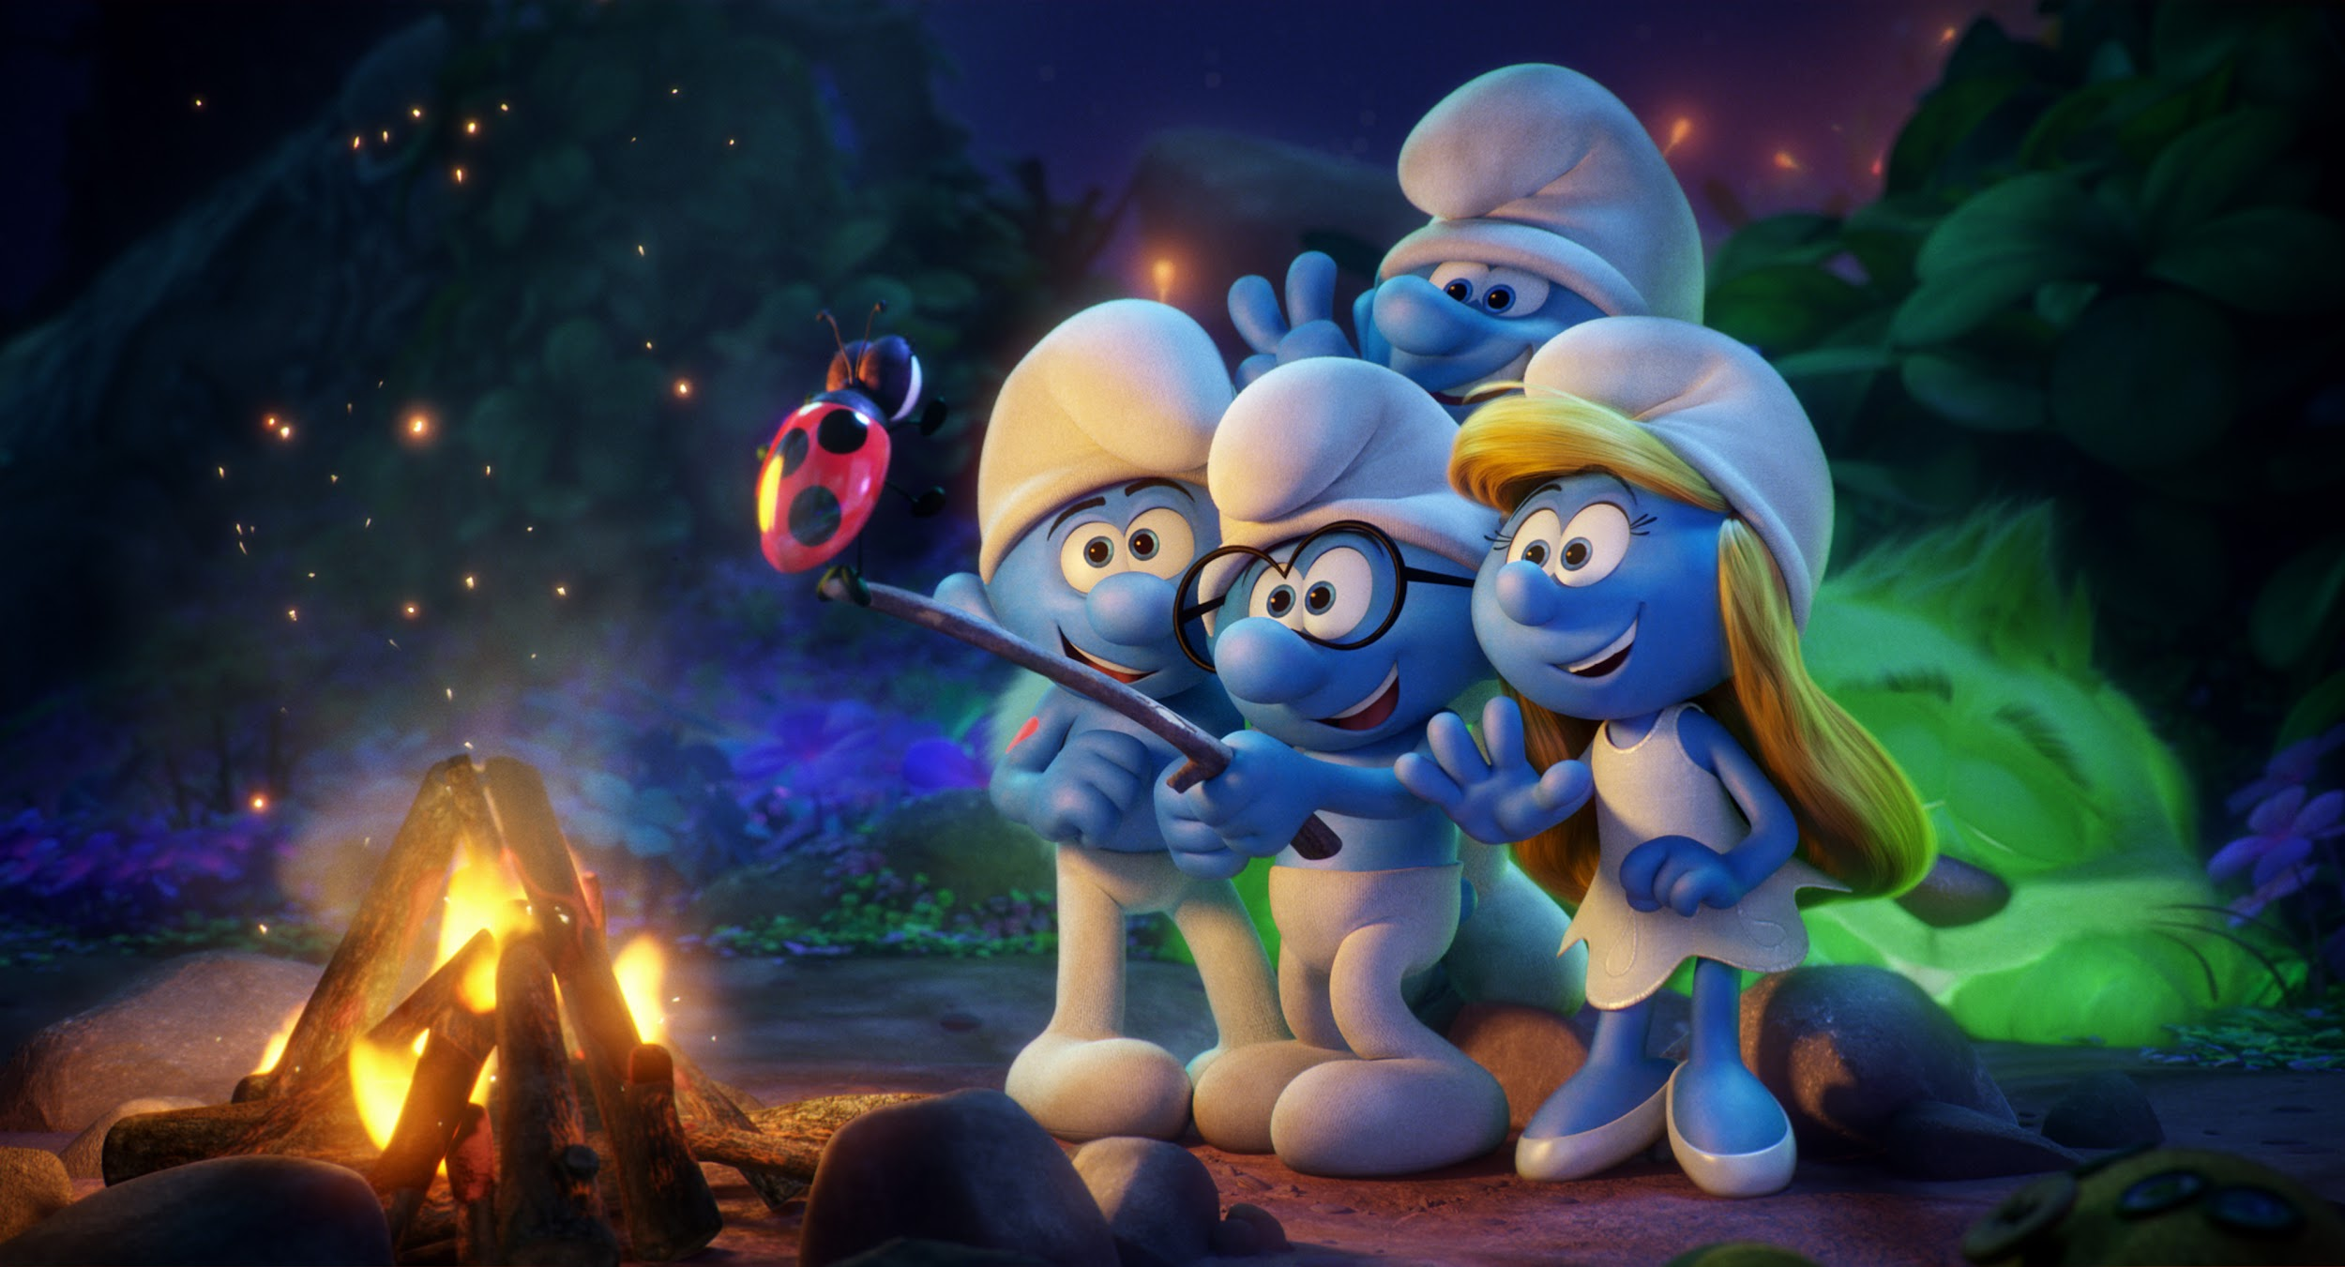
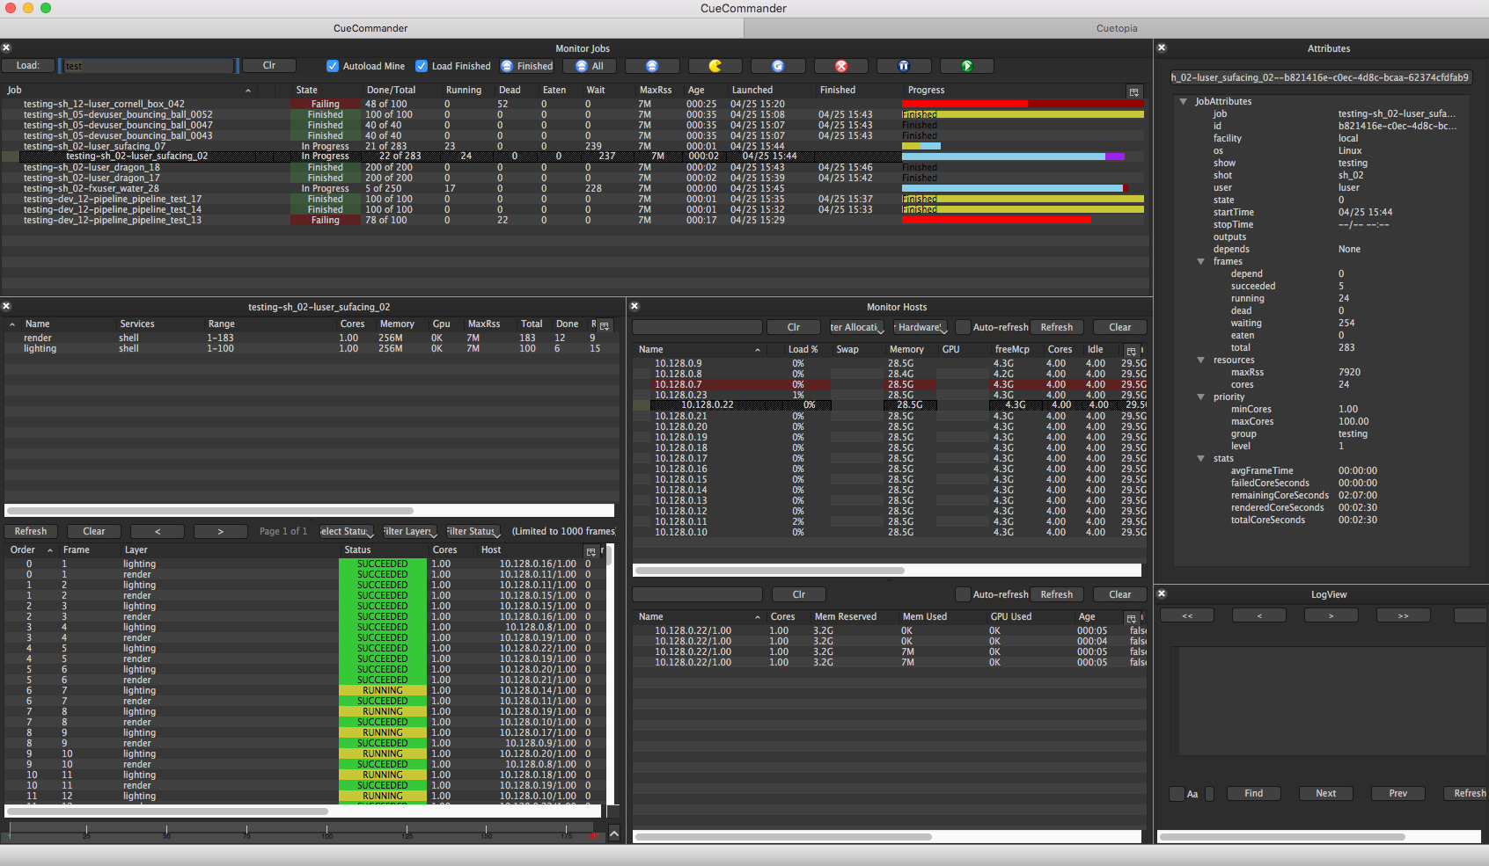

Smurfs: The Lost Village; courtesy of Sony Pictures Imageworks
OpenCue screenshot
Joined ASWF in April 2019.
Developed at Sony Pictures Imageworks as its internal render farm manager (“Cue3”); collaboration with Google Cloud to release as OpenCue in January 2019.
Fully featured render manager for media and entertainment that can be used to break down complex jobs into individual tasks.
Contributors include Imageworks, Google, Netflix, Microsoft, Amazon.
Monthly releases over the past year, including adding Python 3 compatibility, Windows support, new documentation.
opencue.io

Slide 28
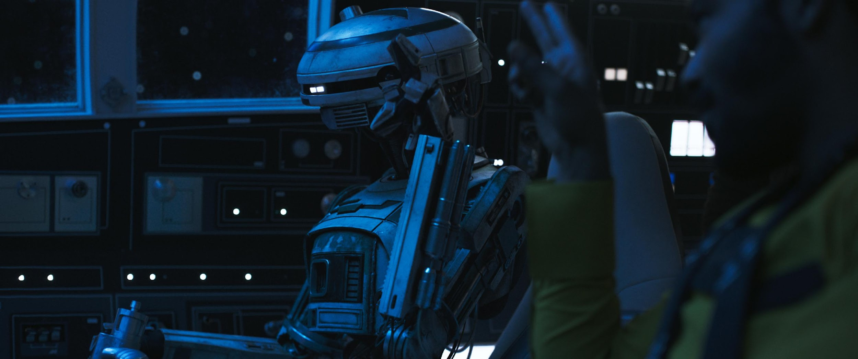
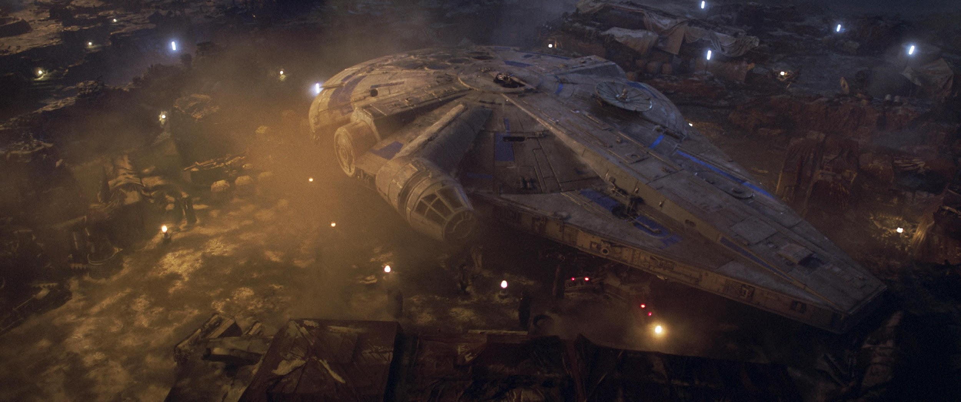
Images from Solo: A Star Wars Story. © and TM Lucasfilm Ltd. All Rights Reserved.
Joined ASWF in April 2019; adopted status in Nov. 2019.
Developed by ILM in 1999; first release of a major open source project by a studio.
High dynamic-range (HDR) image file format for high-quality image processing and storage; widely adopted standard in computer graphics.
Academy Technical Achievement Award recipient.
Key contributors include ILM, Disney Animation, Imageworks, Epic Games, Weta Digital, Pixar, Autodesk, and DreamWorks.
OpenEXR 3.0 just released.
openexr.org

Slide 29
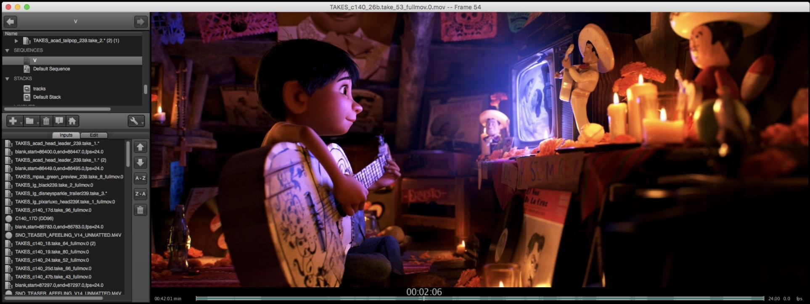
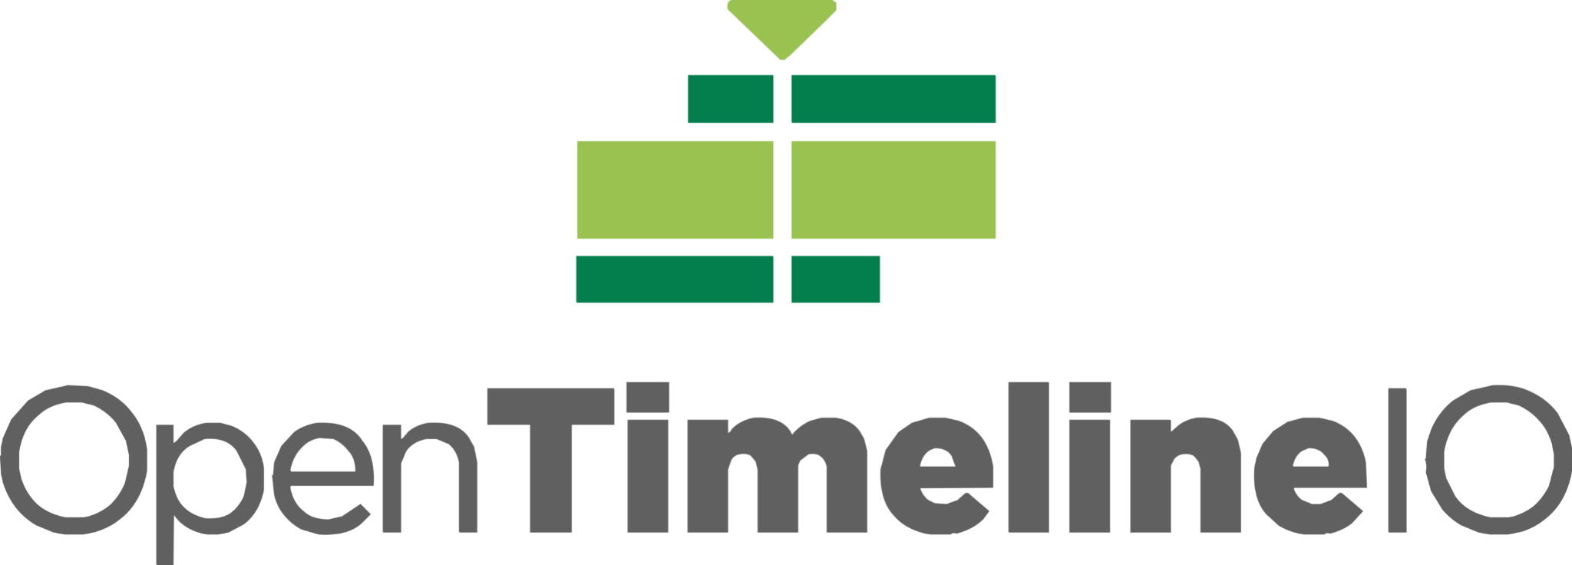
OpenTimelineIO used on Coco for transitions and linking media to the latest renders.
Image courtesy of Pixar Animation Studios.
Joined ASWF in July 2019.
Developed by Pixar Animation Studios.
Open source interchange format for editorial timeline information – clips, timing, tracks, transitions, metadata etc.
Key contributors include Pixar, Netflix, DreamWorks, Autodesk.
In Public Beta
opentimeline.io

Slide 30
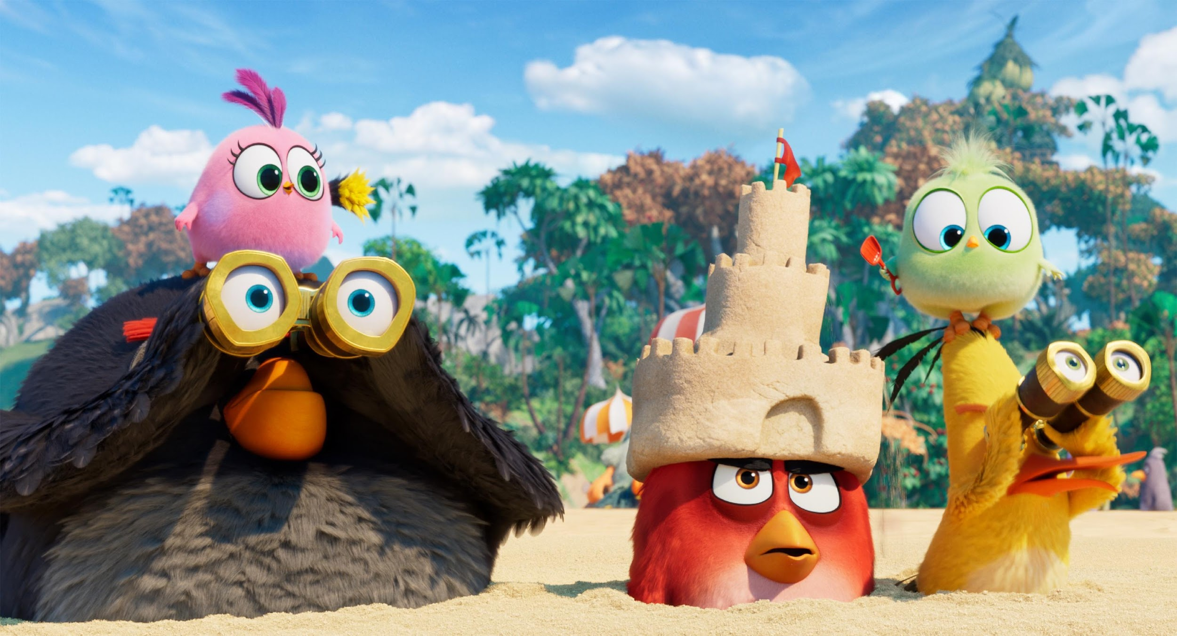
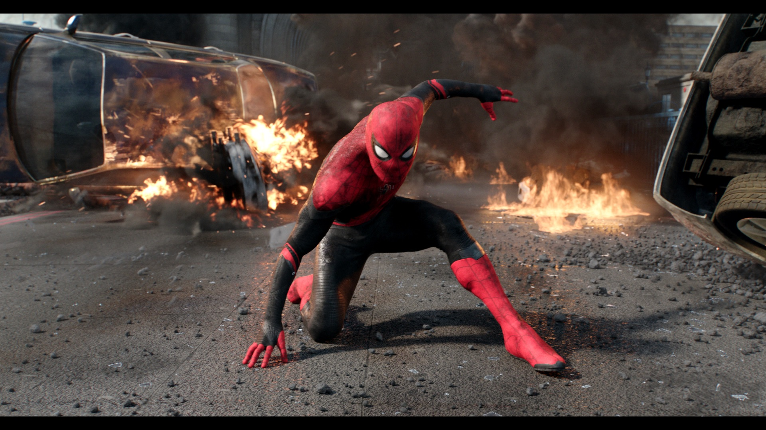
The Angry Birds Movie 2; courtesy of Imageworks
Spider-Man: Far From Home; courtesy of Imageworks
Joined ASWF in April 2020.
Developed by Sony Pictures Imageworks; released as open source in 2010.
De facto standard shading language for VFX and animation, ideal for describing materials, lights, displacement, and pattern generation.
Academy Technical Achievement Award recipient.
Key contributors include Imageworks, Animal Logic, NVIDIA, Pixar, DNEG, Autodesk.
openshadinglanguage.org

Slide 31
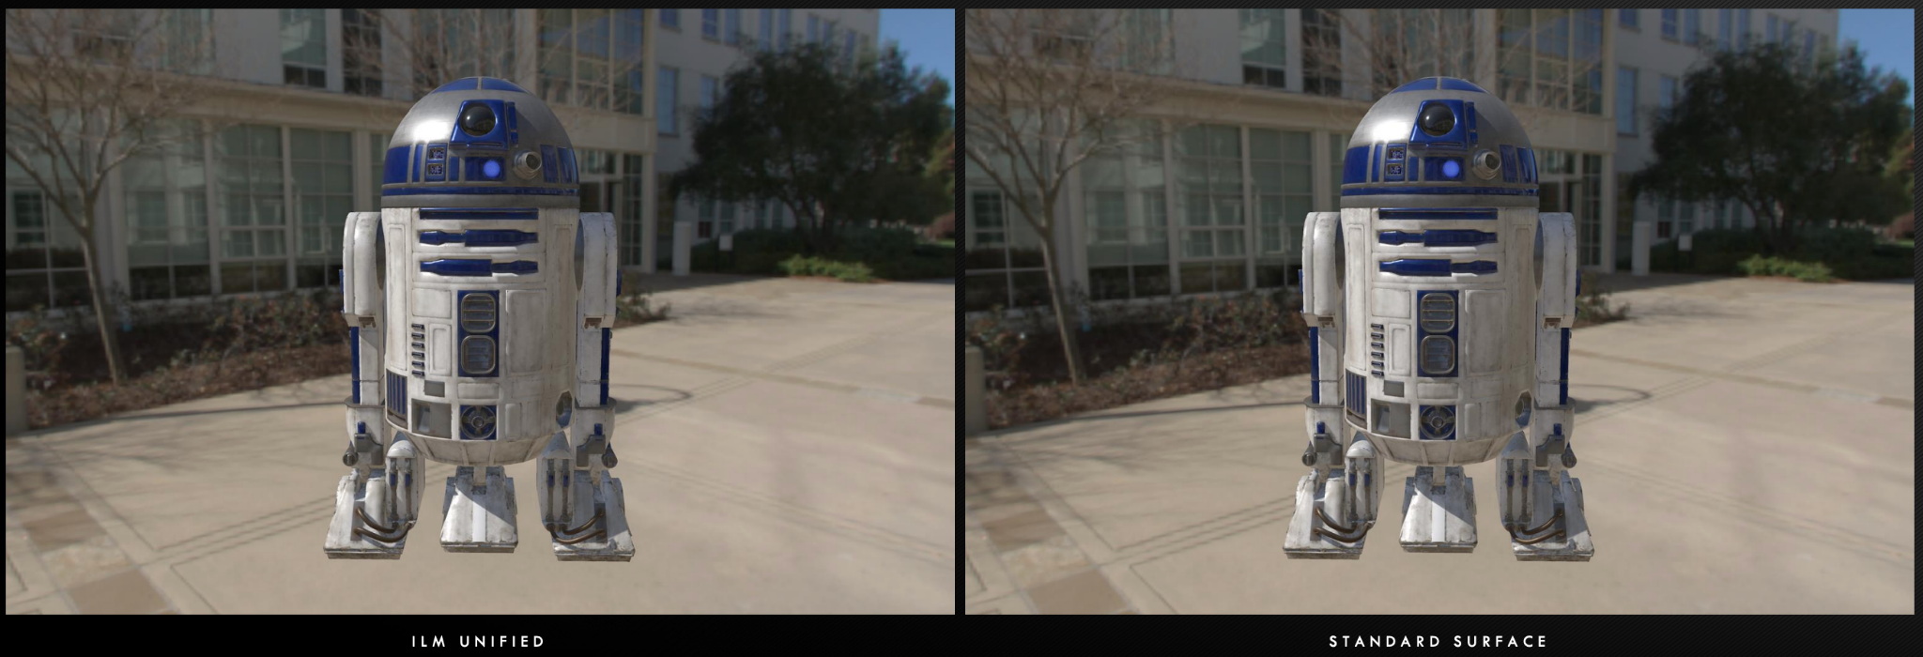

ILM Production tests using MaterialX
Joined ASWF in March 2021.
Open standard for representing rich material and look-development content in computer graphics, enabling its platform-independent description and exchange across applications and renderers.
Launched at Industrial Light & Magic in 2012, MaterialX has been a key technology in their feature films and real-time experiences since Star Wars: The Force Awakens and Millennium Falcon: Smugglers Run.
Key contributors include Sony Pictures Imageworks, Pixar, Autodesk, Adobe, and SideFX.
materialx.org

Slide 32
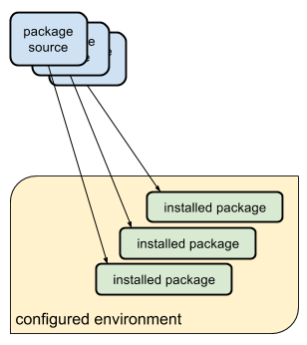
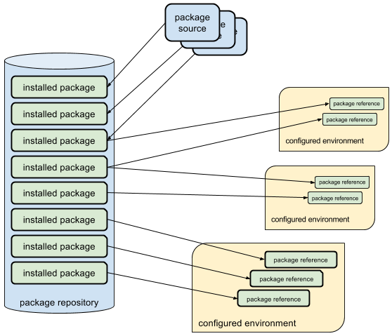

Typical package managers install packages into an environment
Rez installs packages once, and configures environments dynamically
Joined ASWF in February 2022.
Developed by Allan Johns of Method Studios.
Cross-platform package manager that leverages a central repository for storing packages instead of installing into each environment separately, reducing the time to create complex environments to just a few seconds.
Key contributors include Luma Pictures, Method Studios, NVIDIA, and Shotgrid
rez-project.io

Slide 33

New Api
Spectral
Repo
Metadata
Update writing
Lens Functions
HDRI Merging
Bindings
December 2022
Joined ASWF in January 2021.
Software package that converts digital camera raw files to ACES container files containing image data encoded according to the Academy Color Encoding Specification (ACES) as specified in SMPTE 2065-1.
Key contributors include AMPAS and Weta Digital
rawtoaces.org

Slide 34
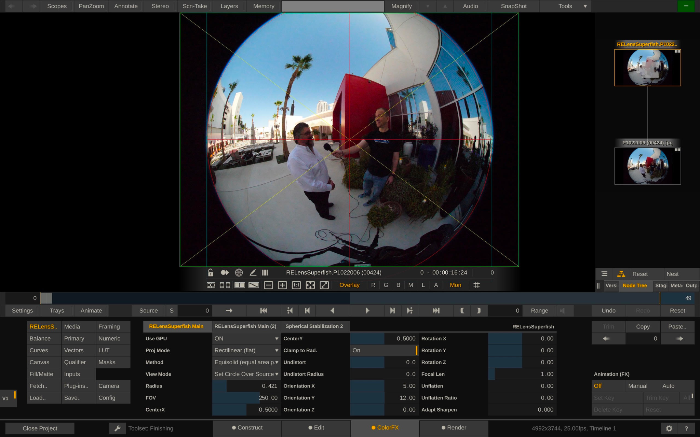
OpenFX Overlay Draw Suite
Industry-wide common interface between image-based visual effects plugins and host applications
Used by Autodesk Flame, Foundry Nuke, Blackmagic Design DaVinci Resolve and Fusion, Sony Catalyst and MAGIX Vegas Pro, Assimilate Scratch, Filmlight Baselight, Boris FX Sapphire and Silhouette, RE:Vision Effects and more.
Open, extensible C API currently version 1.4 with version 1.5 in development.
openeffects.org

Slide 35

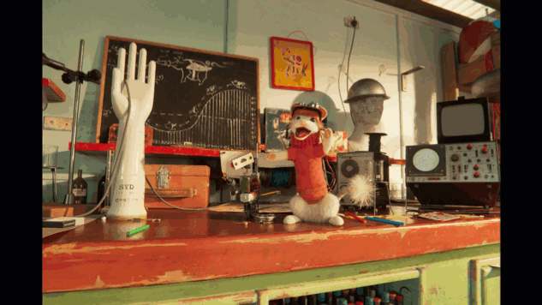

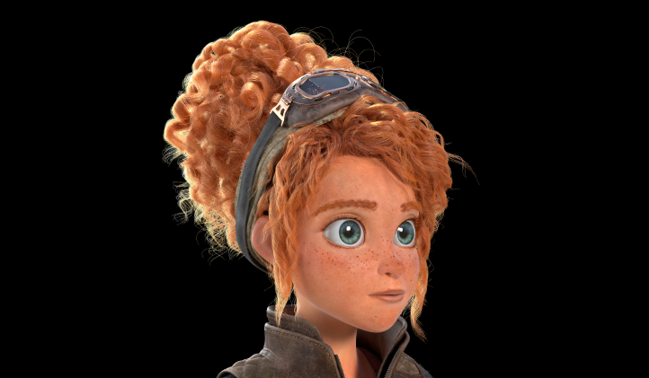
Launching with ASC Standard Evaluation Material II (StEM2), Animal Logic’s ALab Phase 2, Intel’s Volumetric Clouds Library and AWS character Noa.
Providing a vendor-neutral hosting platform and a uniform license agreement, to encourage, curate and publish production-grade sample assets for developers, researchers and educators, Digital Production Example Library is the conclusion of an Academy Software Foundation working group on assets.
dpel.aswf.io

Slide 36
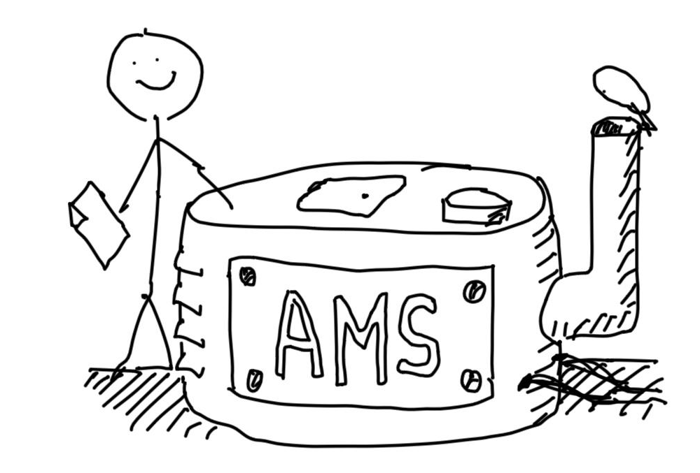















OpenAssetIO is an early stage open source interoperability standard between tools and asset management systems, developed by Foundry with proofs of concept and design input from 15 companies including DNEG, Pixar, Amazon Web Services, Animal Logic, Blizzard, and Blender. OpenAssetIO was the first project to join the Academy Software Foundation in sandbox stage.
openassetio.org

Slide 37



Autodesk’s RV Player
DNEG’s xSTUDIO
An open source project with the mission to build a unified toolset for playback, review and approval of motion picture and related professional media, with Autodesk contributing RV, Dneg contributing xSTUDIO, Imageworks contributing parts of itView, and the three companies providing lead architects and maintainers for the project Technical Steering Committee.
openreviewinitiative.org

Slide 38


Miles Morales (Shameik Moore) and Gwen Stacy (Hailee Steinfeld) take on The Spot (Jason Schwartzman) in Columbia Pictures and Sony Pictures Animation’s SPIDER-MAN™: ACROSS THE SPIDER-VERSE.
OpenImageIO is a library for reading and writing images, and a bunch of related classes, utilities, and applications. There is a particular emphasis on formats and functionality used in professional, large-scale animation and visual effects work for film. OpenImageIO is used extensively in animation and VFX studios all over the world, and is also incorporated into several commercial products.
openimageio.org

Slide 39

An open source project with the mission to develop a royalty-free, open-source, open standard video codec for professional video capturing and post-production.
openapv-tsc@lists.aswf.io
openapv-discussion@lists.aswf.io

Slide 40

ACES (Academy Color Encoding System) is a color management and image interchange framework designed to support motion picture and television production, mastering, and archiving workflows. Developed by the Academy of Motion Picture Arts and Sciences in collaboration with industry professionals, ACES provides standardized transforms and metadata practices for consistent color fidelity across diverse tools and platforms. Originating from early digital color pipeline research in the mid-2000s, ACES has since been adopted in numerous feature films and episodic projects. Its significance lies in its role as a vendor-neutral, open solution that ensures creative intent is preserved from on-set through post and into archive, making it a cornerstone of modern professional image workflows.

Slide 41
Working Groups
Machine Learning Working Group
A working group where the ML experts among our projects and members can meet, share expertise, better understand what ML-based tools are needed in our industry, and where helpful, spin off and guide ML-based open source projects aimed at addressing the specific needs of our film pipelines. #wg-ml
Dailies Notes Assistant (DNA)
The mission of the Project is to develop a tool designed to transcribe dailies meetings, analyze the content using an LLM, and provide a plugin system to integrate into production tracking software.
Rongotai Model Train Club (RMTC)
RMTC is a VFX-specific framework for simplifying the production and deployment of AI/ML models using well-tracked and rights-cleared datasets.

Slide 42




Working Groups

Slide 43

How to contribute
Contribute to an existing project:
Submit a PR with a bugfix or new feature
Pick existing GitHub issue as a sample project
Integrate with a new app / contribute plugin
Help improve project documentation
Submit additional test cases
Join the TSC discussion: dev mailing list, conf calls
Get involved with the TAC or Working Group:
DevOps / CI expertise always useful
Interest / expertise in security especially welcome
Join the TAC discussions: mailing list, conf calls, working groups
More information at tac.aswf.io/engagement

Slide 44
How to participate
Developers can join our mailing lists to stay informed about the code and our projects at lists.aswf.io.
Learn how your organization can support the Academy Software Foundation community at aswf.io/join.
Stay connected to us on Twitter at
@AcademySWF and #ASWF

Slide 45
THANK YOU!
Learn more at aswf.io

